Slide 1
Experience of Education Division Members Survey: Stress and Burnout

Slide 2
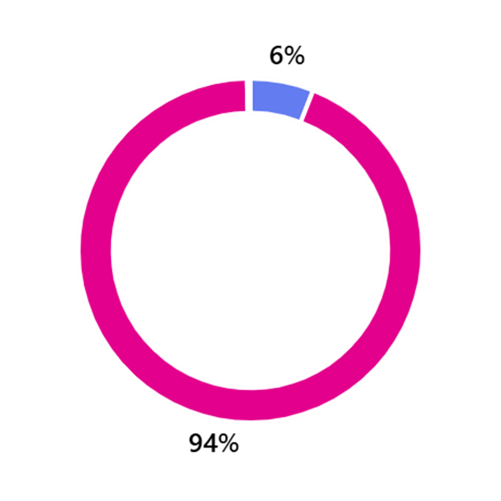
Background - gender / age breakdown
2816 total respondents.
Gender split:
Woman 2640 (94%)
Men 167 (6%)
Age profile:
8-24 11
25-34 166
35-44 563
45-54 1094
55-64 925
65 or over 56

Slide 3
Employment breakdown
Occupation
SNA 2167
School Secretary 258
Clerical Admin role 219
Project Worker 15
Project Co-Ordinator 16
School Caretaker 16
Library Worker 49
Management role 42
Other 34
Primary School 1522
Secondary School 432
Special School 258
ETB 226
Third Level 227
School Completion Prog. 16
Education Centre 14
Other 121

Slide 4
Assault in the workplace
Have you ever been assaulted whilst carrying out your duties? (Overall)
Yes 1537 (54.6%)
No 1279 (45.4%)
Of those who have been assaulted, SNAs make up 96.8% & all other grades make up 3.2%
47.6% needed medical treatment & 37% attended hospital.
41.5% require ongoing treatment or medication.
Only 38.9% felt that their employer was supportive, 61.1% did not or were unsure,
9.4% were offered counselling or other supports after the assault.

Slide 5
Assault in the workplace
Did your employer provide any assistance with medical expenses? (Overall)
Yes 395 (54%)
No 336 (46%)
Of those who received assistance 29% found accessing assistance difficult or were unsure on this point; 71% found it easy and straightforward.
23.2% of recoveries took 1 month or longer, 76.8% recovered in less than 1 month
63.9% were comfortable describing their experience as an assault however, 19.3% were not sure and 17.8% felt this was not an appropriate description.
Overall 58.4% witnessed a colleague being assaulted at work however of SNA respondents 93% had witnessed assault.
Of those who work with students 83.2% would be comfortable with describing injury as resulting from assault by a student/young person.

Slide 6
Assault in the workplace
Do you have access to an Assault Leave Scheme in your workplace? (Overall)
Yes 921 (32.71%)
No 457 (16.22%)
Not Sure 1438 (51.07%)
Worryingly, 52.3% of SNA respondents still are not aware of the Assault Leave Scheme
Overall only 36.36% of respondents believe their employer can maintain a safe work environment.
Of SNA respondents, 70% do not believe this or are unsure as to their employers ability to maintain this safe work environment.
30.7% believe that their employer has conducted a proper risk assessment & of SNAs this figure drops to 26.7%. Overall 40.4% do not feel that a proper risk assessment has not been done

Slide 7
Injury in the workplace
Have you ever been injured at work? (Overall)
Yes 953 (33.84%)
No 1743 (61.89%)
Prefer not to say 120 (4.26%)
How severe was the injury?
Minor 229 (24.03%)
Moderate 456 (47.85%)
Severe 268 (28.12%)
Was the injury caused by a safety hazard that you believe could have been prevented?

Slide 8
Injury in the workplace
Nature of the injuries

Slide 9
Injury in the workplace
83.35% reported the injury.
59% rated the employer resp. as satisfactory or better, 41% described the resp. as neutral.
Only 17.3% believe that there are no measured that can be taken to improve their workplaces safety.
51% do not receive regular safety training or briefings related to their role, 14.35% get regular briefings and the remainder get occasional briefings.
How confident are you in the employer’s commitment to workplace safety?
Confident 1338 (47.68%)
Neutral 747 (26.32%)
Unconfident 731 (26%)

Slide 10
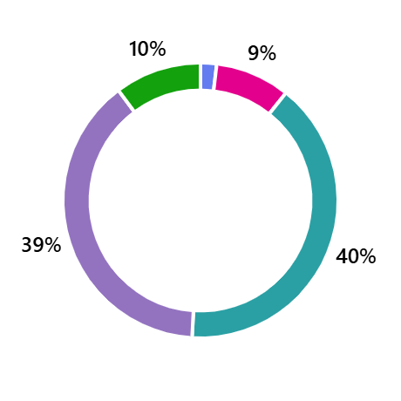
Stress and burnout questions
How often do you feel stressed at work?
Never 53 (2%)
Rarely 248 (9%)
Sometimes 1135 (40%)
Very often 1093 (39%)
Always 287 (10%)

Slide 11
Stress and burnout questions
There is a satisfactory level of support at work for managing stress:
52.9% disagreed or strongly disagreed, and only 20.5% agreed or strongly agreed.
Strongly disagree - 17.4%
Disagree - 35.5%
Agree - 16.7%
Strongly agree - 3.8%

Slide 12
Stress and burnout questions
In your opinion, what could be done to reduce stress in the workplace?
Most common responses included:
Improved communication with management
More training and CPD
Increased staffing
Improved compliance with / addressing Health & Safety issues

Slide 13
Stress and burnout questions
I feel emotionally drained from my work:
51.2% answered very often or always, while 33.9% said sometimes, and only 14.9% rarely or never.
Always - 16.5%
Very often - 34.7%
Sometimes - 33.9%
Rarely - 12.2%
Never - 2.7%

Slide 14
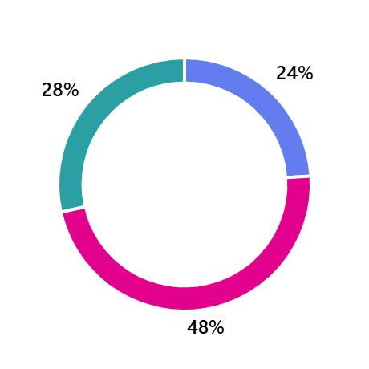
Stress and burnout questions
Do you feel you have enough support at work to prevent or manage burnout?
Yes 666 (24%)
No 1324 (48%)
Not sure 793 (28%)

Slide 15
Stress and burnout questions
I feel like quitting my job because of burnout:
17% answered very often or always, while 30.2% said sometimes, and 52.9% rarely or never.
Always - 5.4%
Very Often - 11.6%
Sometimes - 30.2%
Rarely - 21.6%
Never - 31.3%

Slide 16
Stress and burnout questions
I often feel that my work makes a difference:
73.3% agreed or strongly agreed, while only 8.9% disagreed or strongly disagreed.
Strongly agree - 24.8%
Agree - 48.5%
Neutral - 17.9%
Disagree - 6.4%
Strongly disagree - 2.5%

Slide 17
Conclusions
Stress is an issue for members in workplaces in the Education sector.
89% of respondents cited being stressed some of the time, 49% on a regular basis.
Issues around communication and HR practices, specifically in schools were cited.
There is a need for greater supports in relation to stress and burnout.
47.2% of respondents have considered leave their job citing burnout, 17% on a regular basis.
Members in the Education sector are proud of their work, are highly motivated and feel a strong sense of achievement in respect of its contribution both to the sector and in wider society.

