Slide 1
Four Day Week Ireland
#4DayWeek #Better4Everyone

Slide 2
Four Day Week Ireland
Build on success of ‘Future of Working Time’ conference, Nov 18
Advocate for a gradual, steady, managed transition to a shorter working week for all workers (public and private sector)
Start a public conversation about the case for reduced working hours
Response to technological change – Preparing for future, sharing the benefits
Medium term objective – To move towards the four day week being the standard work arrangement across the economy, with no loss of pay

Slide 3
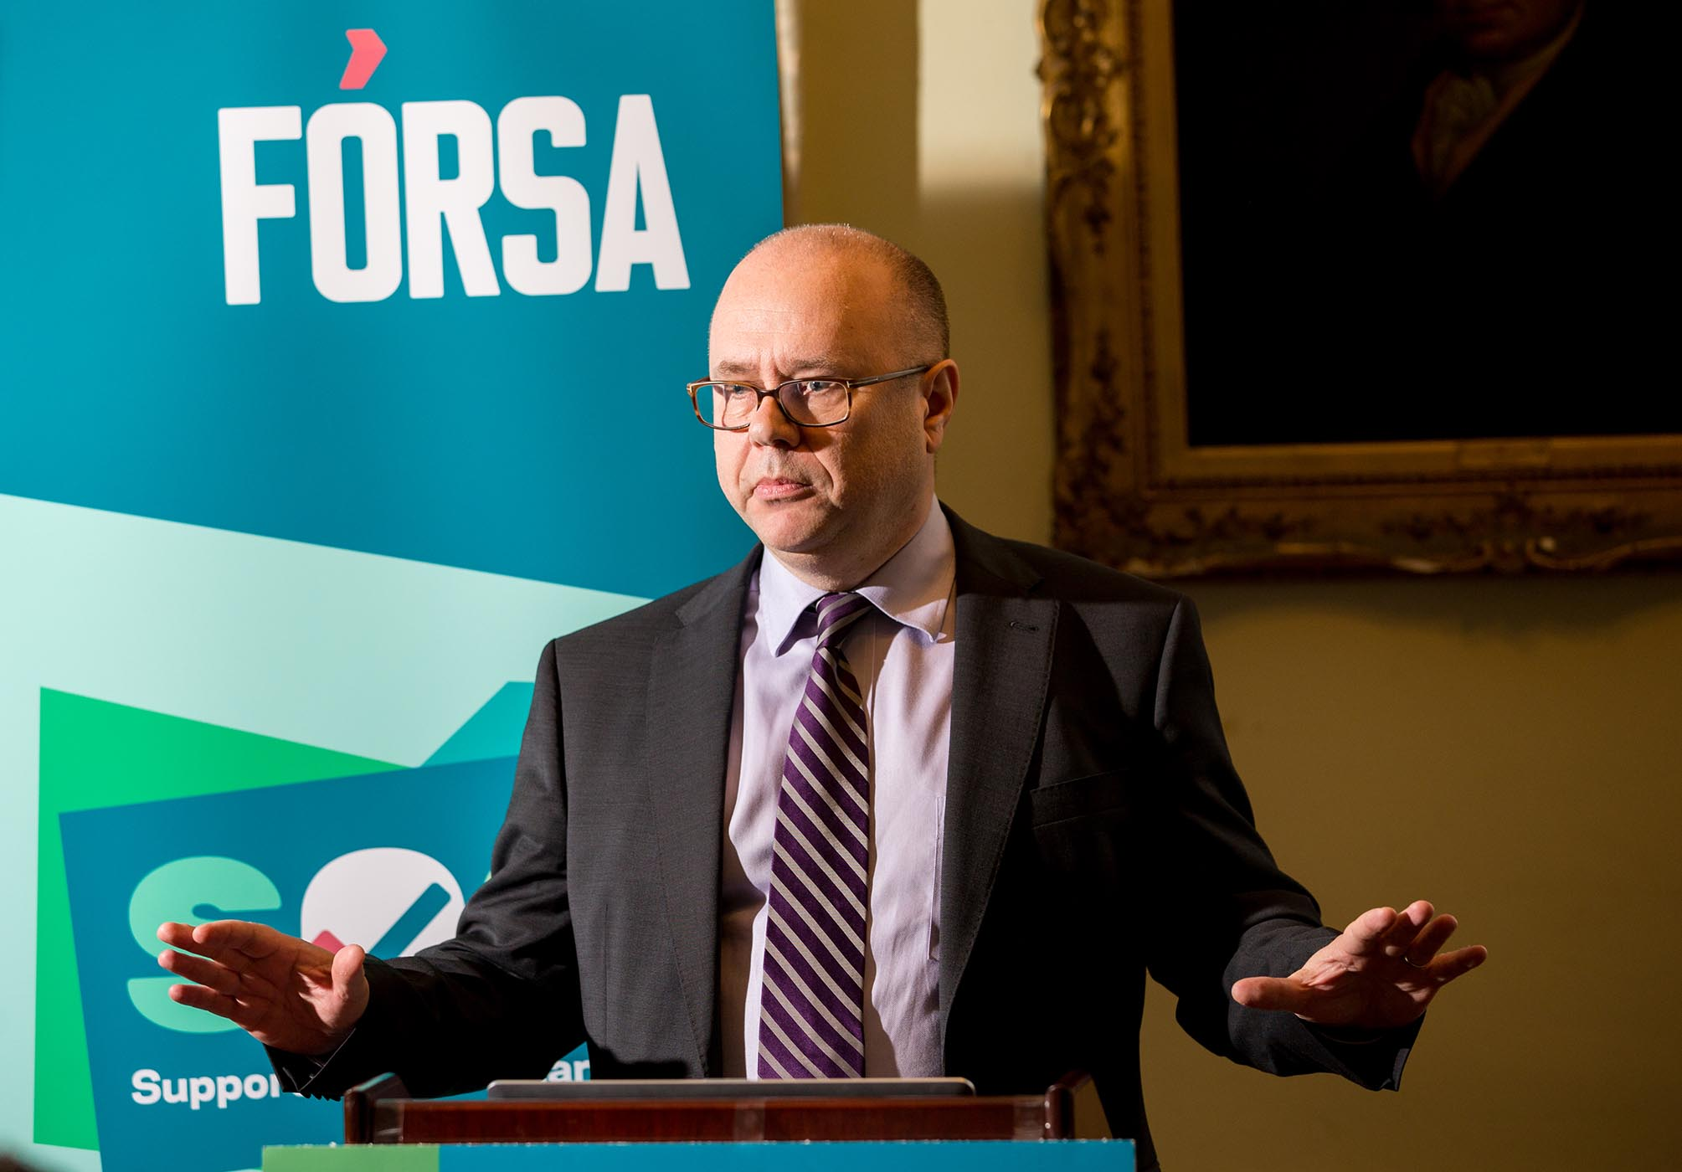
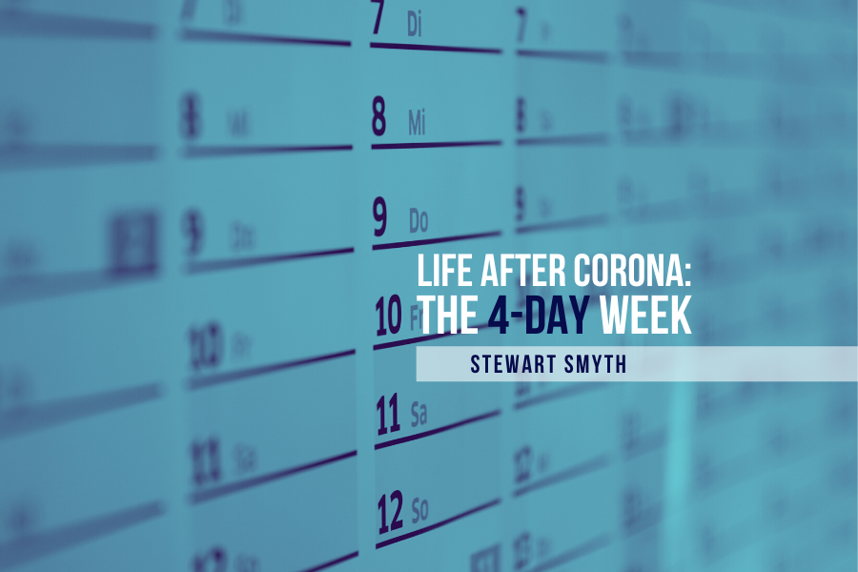
Four Day Week Ireland
Part of overall Fórsa strategy on hours
Change the conversation – Shift political & media narrative
Adjust messaging to reflect changed political, economic and social climate – COVID19

Slide 4
What it is not
As with the five day week today, it will not be the only work arrangement – For some sectors, employments and workers, different variances of reduced working hours and a shorter working week will need to co-exist alongside the benchmark of the four day week.
We do not mean that everyone will have a ‘three day weekend’ – Strong management, extensive employee engagement and clever rostering will need to ensure that businesses and public services can function for 5 or in some cases even 7 days, alongside a shorter working week for all workers.

Slide 5
It sets out to…
Be a landmark, flagship campaign for the Irish trade union movement and civil society
Build a public movement for a four day week in Ireland
Put working time back at the centre of the political agenda
Change the public conversation and media narrative on working hours
Change the false narrative that working long hours is good for productivity and a badge of honour
Challenge the worst excesses of the ‘work-first, always-on’ culture
Champion the importance of family time, leisure time, caring work and community work

Slide 6
4DWI Steering Group
Pillars: Unions, businesses, environment, civil society, women, academics
Fórsa - Laura Bambrick (ICTU)
National Women’s Council - FOE Ireland
ICE (Galway based business) - Aileen O’Carroll (MU)
Perpetual Guardian / 4DWGlobal - Aidan Harper (4DW UK)
Health representative / practitioner required

Slide 7
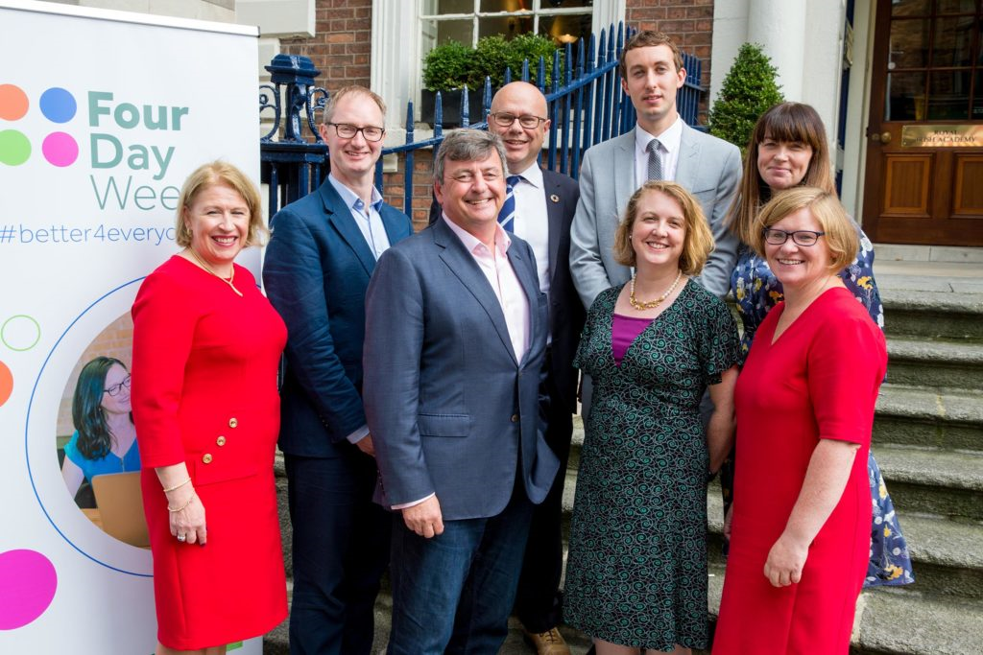
Campaign Launch – 27th September 2019

Slide 8
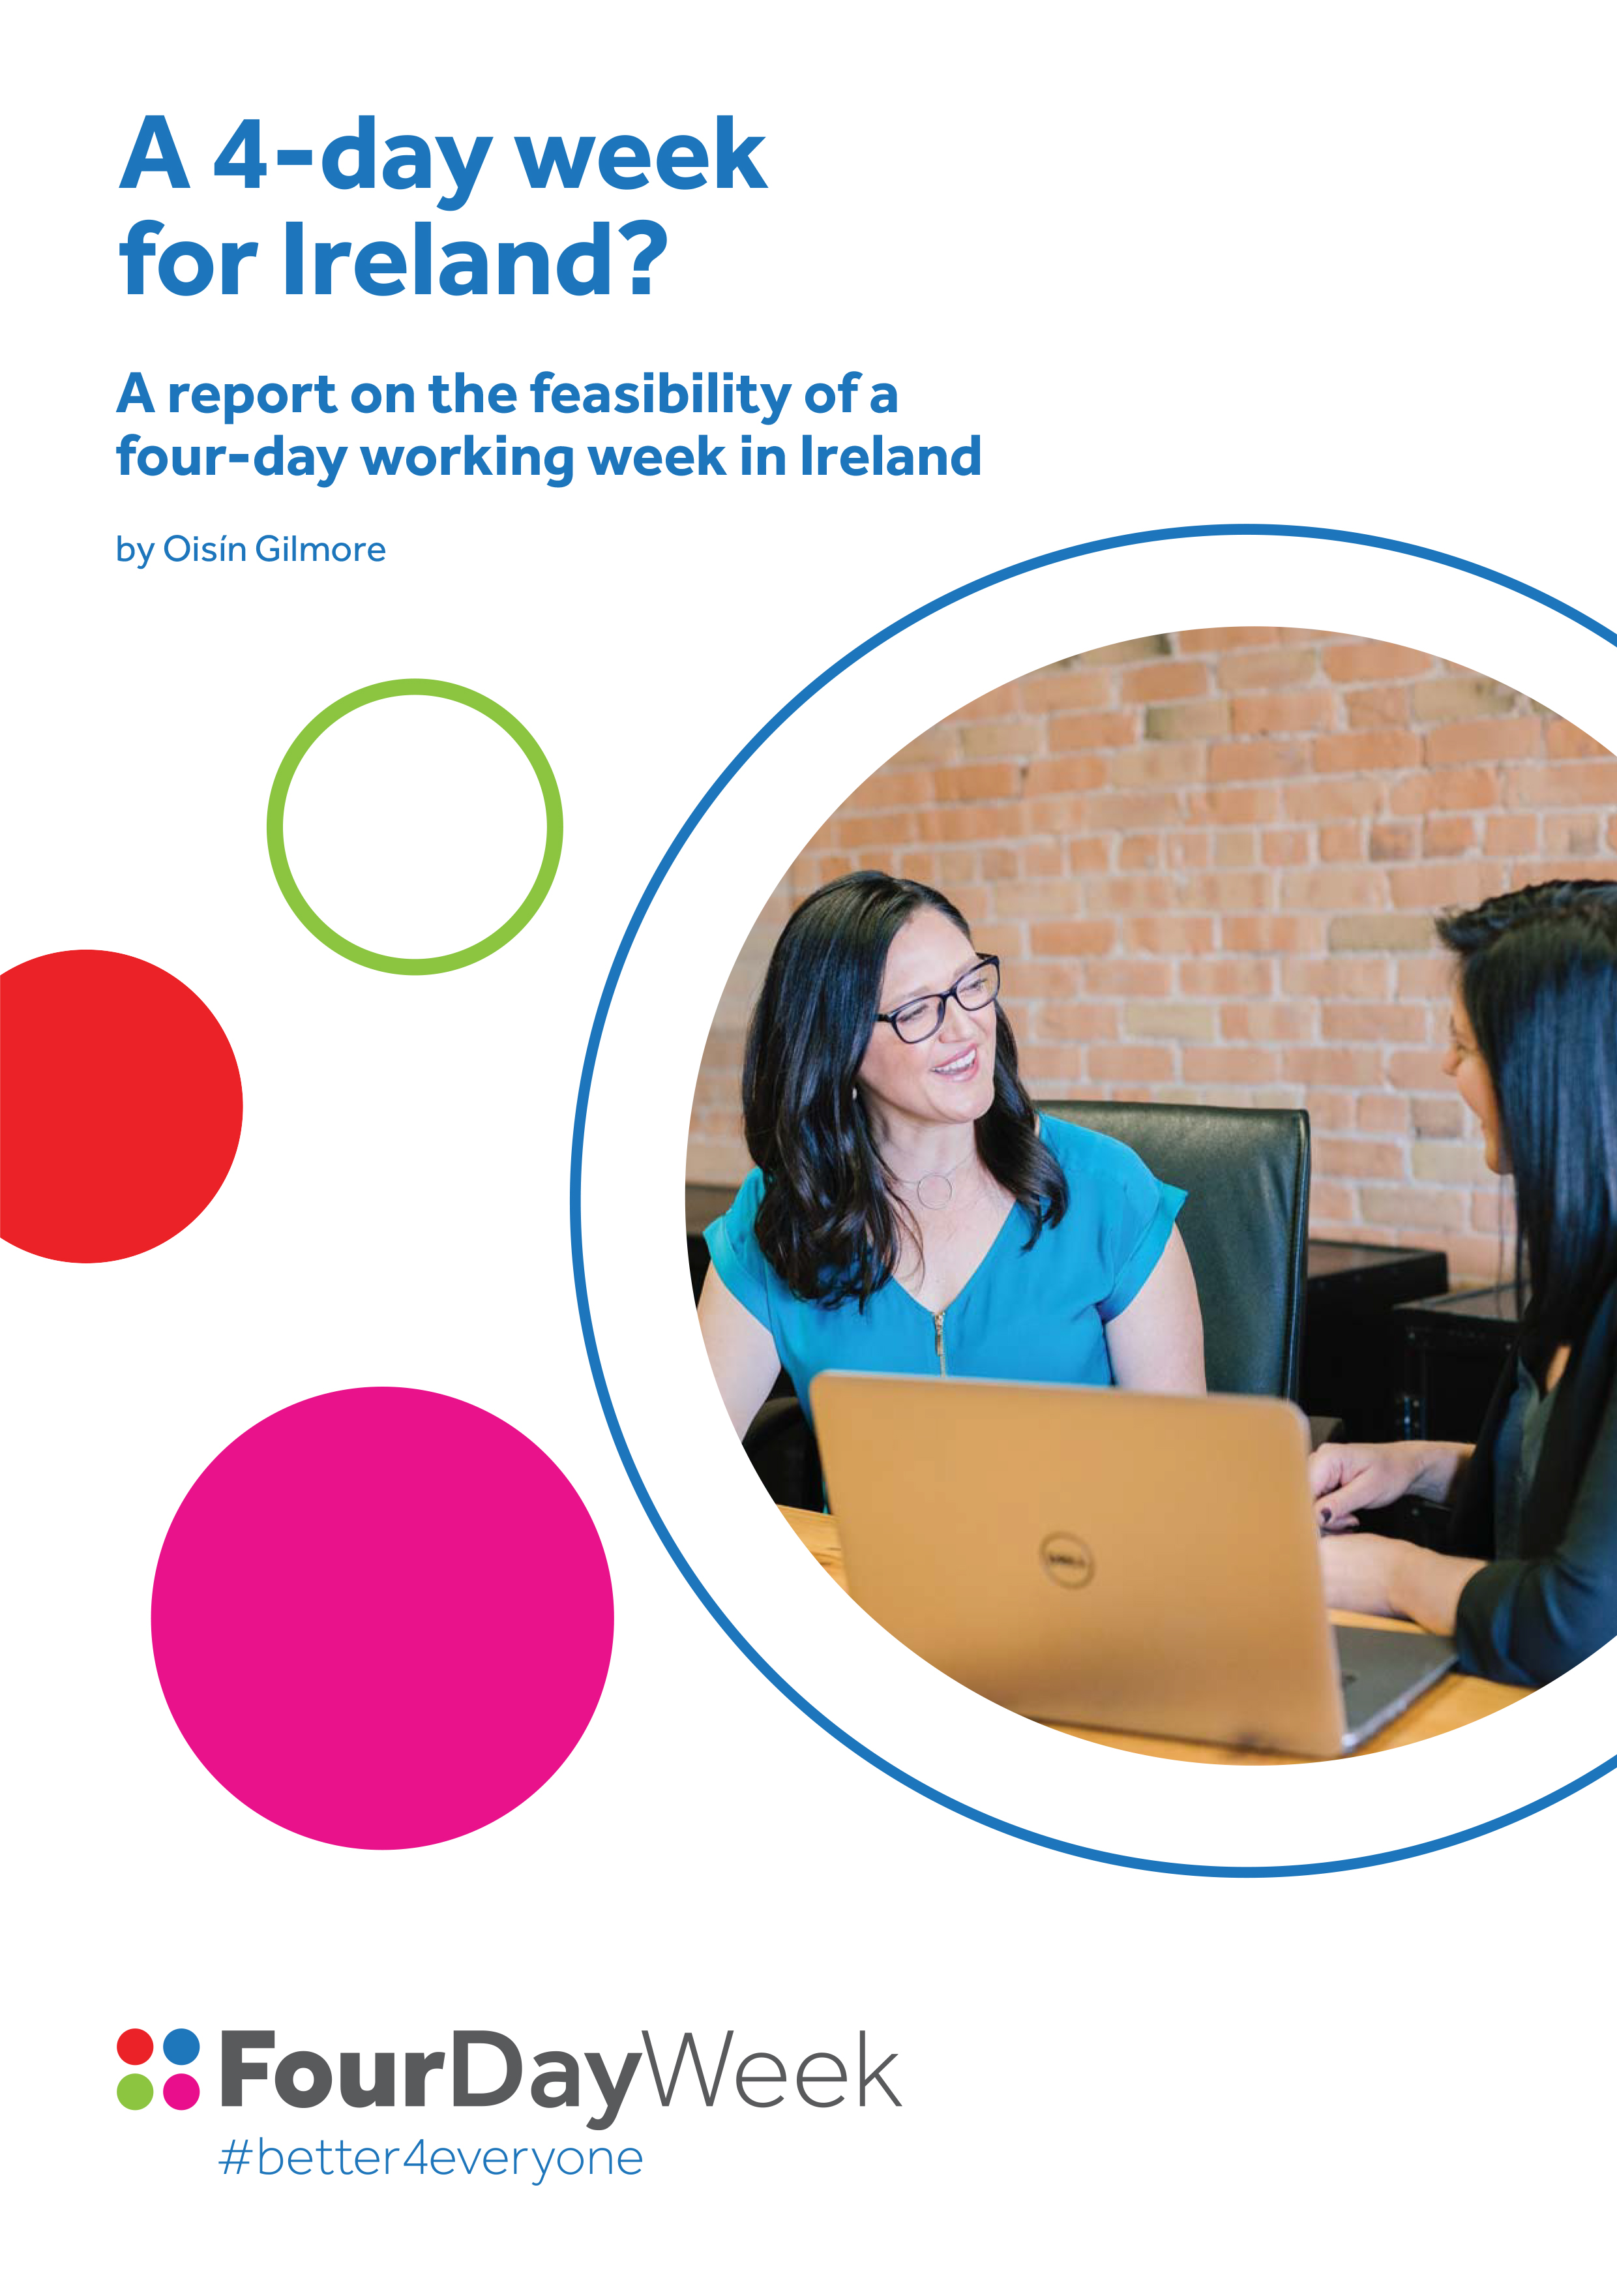
4DWI Policy Paper
The working week up to now – History, the need for intervention, recent trends
The working week, welfare and economic growth
Looking forward: A 4 Day Week
Benefits – Leisure, family, children, caring, aging, sustainability, health, equality
Case studies – UK, France, Sweden, New Zealand
Do people want this? – Fórsa survey / TUC / Ricoh

Slide 9
Our Core Messages
4-day week/reduced working time is achievable and good for business/productivity
4-day week/reduced working time is good for workers; In context of (historical) reductions in working time on foot of major shifts in technology
4-day week/reduced working time can bring environmental benefits; In context of climate action
4-day week/reduced working time in context of work-life balance and modern (and increasing) caring responsibilities.
4-day week/reduced working time will allow men to spend more time with their families and take on more caring responsibilities, and remove barriers to women achieving senior positions in work

Slide 10
Media Coverage
Virgin Media News
RTÉ
Irish Times
Irish Independent
Drivetime RTÉ
Saturday RTÉ
Last Word with Matt Cooper (Today FM)
Dermot & Dave (Today FM)
Newstalk Breakfast
The Hard Shoulder with Ivan Yeats (Newstalk)
Lunchtime Live (Newstalk)
The Journal
Joe.ie / Her.ie / Buzz.ie / Extra.ie
Reddit World News
Irish Sun
Irish Mirror
Irish Post
IMAGE Magazine
Host of local and regional radio

Slide 11
Media Coverage

Slide 12
Fórsa survey
5,619 respondents (97.6% public sector)
2 in 5 believe work life balance is unsatisfactory or a major issue
Over 4 in 5 respondents (80.17%) believe automation, AI and new developments in technology will either change or replace their current job (Projected 4,000 jobs displaced across Fórsa membership)
84.55% of respondents believe they could either increase or maintain their current productivity with reduced working hours (54.56% say it would increase)
Over 1/2 of respondents (51.84%) would prioritise spending their additional non-working time on increased time with their family. Almost 3 in 10 (29.69%) would prioritise increased leisure time, and current and new hobbies and interests. 14.66% would use it primarily to cater for their caring responsibilities
87.29% believe that reducing their working hours would also reduce their work-related stress and increase their wellbeing (6.86% - ‘work intensification’)

Slide 13
Fórsa survey
Given the choice for reducing working hours, the vast majority would have a preference for a 4 day week – 64.57%. Only 8.97% would opt for a 5 day week with proportionate daily reductions in working hours.
71.62% believe that the Four Day Week is a realistic and achievable medium term ambition for trade unions. 15.23% believe that it is not. When the 13.15% of don’t knows are excluded, 82.46% believe the 4 day week is a realistic, achievable objective for unions.
4 in 5 (80.34%) believe that trialling a 4 day week in their department or section would be both desirable for them and their colleagues, and feasible in terms of productivity. When the 11.03% of don’t knows are excluded, over 9 in 10 (90.3%) believe that a 4 day week trial is desirable and feasible in their work context

Slide 14
Current activity
B&A public opinion survey Sept 17

Slide 15
The questionnaire used
The questionnaire below was included as one element of a multi-topic survey. The questionnaire is interviewer-administered and the data is recorded on a tablet computer and stored and transmitted in encrypted format.
Q.1 ‘Given advancements in technology, do you believe a four-day week is a realistic and achievable ambition in the medium term?” (By a four day week we mean doing the same job, achieving the same goals and being paid the same salary, but doing this over 4 days rather than 5)
Q.4 And finally could you describe the nature of your role under the following headings
Public or private sector (indicate one) | Public sector/state/semi state | 1
 | Private | 2
Tenure (indicate one) | Full time | 1
 | Part time | 2
 | Other | 3
Responsibility (indicate one) | Employer/owner/self employed | 1
 | Employee | 2
Sector (indicate one) | Manufacturing | 1
 | Office based/administrative | 2
 | Retail/shops/distribution | 3
 | Education | 4
 | Services | 5
 | Other | 6
Grade (indicate one) | Professional | 1
 | Technical | 2
 | Skilled | 3
 | Semi-skilled | 4
 | Unskilled | 5
Strongly believe it is achievable | Broadly believe it is achievable | Not really sure | Don’t really believe it is achievable | Don’t at all believe it is achievable
1 | 2 | 3 | 4 | 5
Q.2 Do you believe that trialling a four-day week in your own place of work -without loss of pay or productivity- would be both desirable for employees and feasible for the employer? Probe for each
 | YES | NO
Desirable for employees | 1 | 2
Achievable for employers | 1 | 2
Q.3 ‘'To what extent would you support or oppose the government exploring the introduction of a four day working week?”
Would strongly support | Would generally support | Would neither support nor oppose | Would generally oppose | Would strongly oppose
1 | 2 | 3 | 4 | 5

Slide 16
Sample profile
Base: All Adults 1,020/3,839,000
EMPLOYMENT
SECTOR
TENURE
(All Adults)
(All Workers)
(All Workers)
%
%
%
Public
Private
Working
Non Working
Part time more prevalent unskilled and in shops
Slightly more than half of the adult population works
A quarter work in the public sector
Full Time
Part Time
Other
Retail etc 37%
Education 19%
Services 21%
Semi skilled 37%
Unskilled 57%
RESPONSIBILITY
SECTOR
GRADE
(All Workers)
(All Workers)
(All Workers)
%
%
%
Employer
Employee
Manufacturing
Office based/administrative
Retail/shops/distribution
Education
Services
Other
Professional
Technical
Skilled
Semi-skilled
Unskilled
Analysis of Sample

Slide 17
Analysis of working sample
Base: Working Adults – 554/2,042,000
All Workers |  | U25* | 25-34 | 35-49 | 50-64 | 65+* |  | ABC1 | C2DE | F*
% |  | % | % | % | % | % |  | % | % | %
Public
Private
SECTOR
%
Full Time
Part Time
Other
TENURE
%
Employer
Employee
RESPONSIBILITY
*Small base sizes
Analysis of Sample

Slide 18
Two out of three feel that a 4-Day week is a realistic and achievable ambition
Base: All Adults 16+ - 1,020/3,839,000
Any Achievable
Gender:
%
Work Status:
%
%
Age:
Strongly believe it is achievable (5)
Broadly believe it is achievable (4)
Not really sure (3)
Don’t really believe it is achievable (2)
Don’t at all believe it is achievable (1)
Sector:
Responsibility:
Social Class:
Mean Score 3.88/5.00
Two thirds believe that a 4-Day week could be realistic and achievable, with stronger conviction younger, among employees and more particularly those working in the public sector. The self-employed, farmers and older adults are somewhat more skeptical, although even a majority of employers (53%) suspect it may be realistic and achievable.
Q.1 ‘Given advancements in technology, do you believe a four-day week is a realistic and achievable ambition in the medium term?” (By a four day week we mean doing the same job, achieving the same goals and being paid the same salary, but doing this over 4 days rather than 5)

Slide 19
Perspectives of trialling a 4-Day week - without loss of pay or productivity – in own workplace
Base: All Adults 16+ - 1,020/3,839,000
Desirable for Employees
Achievable for Employers
No
No
%
%
Yes
Yes
Employer 69%
Employee 85%
Employer 46%
Employee 65%
Three out of four believe that trialling a 4-Day week would be desirable for employees while three in five feel that it should be achievable for employers. Just over half of employers (54%) doubt that it would be achievable for them (although margin of error wider.)
Q.2a Do you believe that trialling a four-day week in your own place of work -without loss of pay or productivity- would be desirable for employees?
Q.2b Do you believe that trialling a four-day week in your own place of work -without loss of pay or productivity- would be feasible for the employer?

Slide 20
Working adults view of a 4-Day week trial in their own workplace
Base: All Working Adults – 554/2,042,000
Desirable for Employees
Achievable for Employers
Work Status:
%
Work Status:
%
Sector:
Sector:
Responsibility:
Responsibility:
Sector:
Sector:
Grade:
Grade:
The vast majority of workers, irrespective of grade or sector, are enthusiastic about a potential trial. Stronger support among the more skilled grades and those office based. Less than half of employers feel it may be achievable, while recognizing that almost 7 in 10 of their employees would find it desirable.
Q.2a Do you believe that trialling a four-day week in your own place of work -without loss of pay or productivity- would be desirable for employees?
Q.2b Do you believe that trialling a four-day week in your own place of work -without loss of pay or productivity- would be feasible for the employer?

Slide 21
Should Government explore introduction of a 4-Day week?
Base: All Adults 16+ - 1,020/3,839,000
Support (All Adults)
All Adults
1,020
%
All Working
554
%
Strongly support
Generally support
Strongly support
Generally support
Gender:
Work Status:
UK:
Age:
Would strongly support
Would generally support
Neither support nor oppose
Would generally oppose
Would strongly oppose
UK (Age)
18-34 72%
35-44 64%
45-54 68%
55-64 56%
65+ 50%
Sector:
63%
Responsibility:
Social Class:
25%
12%
Mean Score 4.15 4.26
More than three in four are supportive of the Government exploring the potential introduction of a 4-Day week, surpassing the level recorded in the UK, although mirroring the pattern of response by age in particular. Even among employers more than three out of four are enthusiastic and only the self-employed seem notably dubious.
Q.3 To what extent would you support or oppose the government exploring the introduction of a four day working week?”

Slide 22
Factoring out the undecided, the result is unambiguous
A realistic & achievable ambition
Excluding those undecided
All Adults
%
Don’t believe at all
Don’t really believe
Strongly believe it is achievable (5)
Broadly believe it is achievable (4)
Not really sure (3)
Don’t really believe it is achievable (2)
Don’t at all believe it is achievable (1)
More than 4 in 5 of those expressing an opinion feel it is a realistic & achievable ambition
%
Strongly believe
Strongly believe
Should it be trialled
Excluding those undecided
All Adults
%
Strongly oppose
Generally oppose
Would strongly support
Would generally support
Neither support nor oppose
Would generally oppose
Would strongly oppose
Of those with an opinion, 93% would favour a trial
Generally support
%
Strongly support
Q.1 ‘Given advancements in technology, do you believe a four-day week is a realistic and achievable ambition in the medium term?” (By a four day week we mean doing the same job, achieving the same goals and being paid the same salary, but doing this over 4 days rather than 5)
Q.3 To what extent would you support or oppose the government exploring the introduction of a four day working week?”

Slide 23
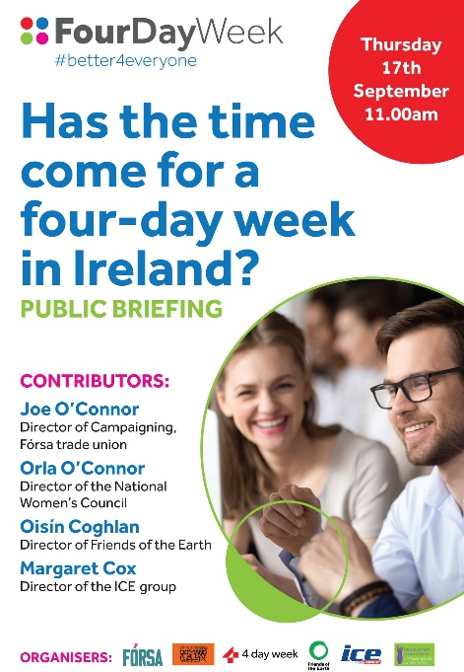
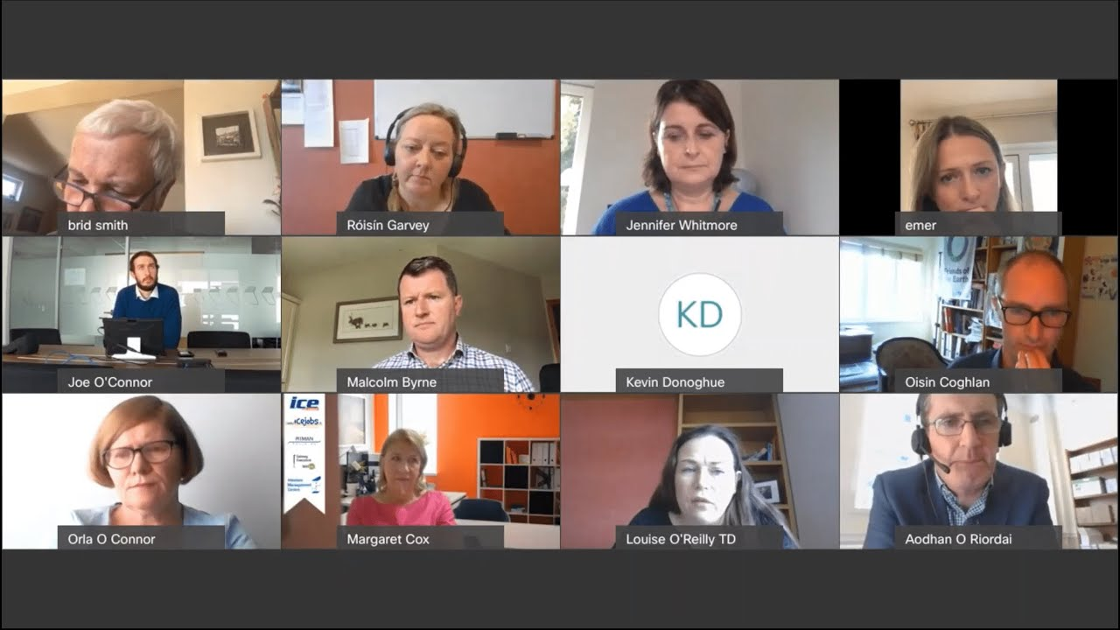
Current activity
Cross-party Oireachtas briefing 17th Sept

Slide 24
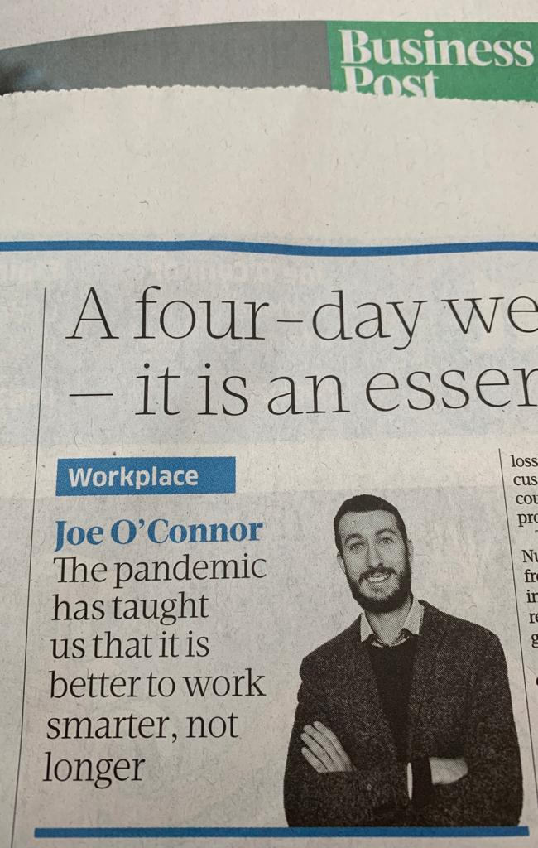
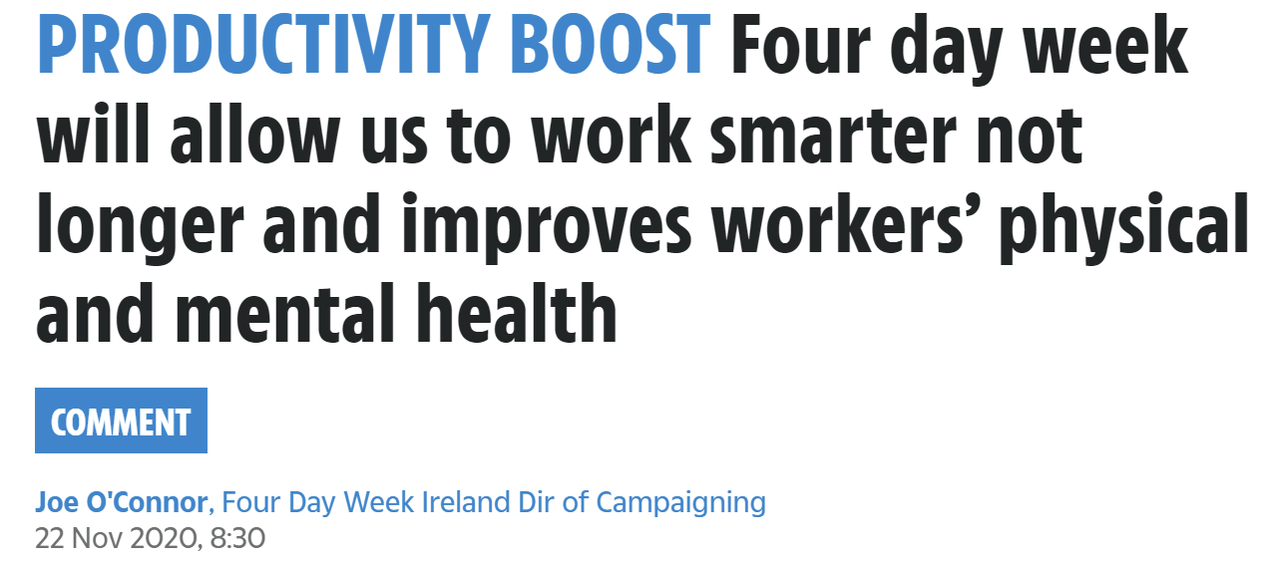
Current activity
Media coverage

Slide 25
Achieving a 4 Day Week
Labour market competition (Public demand & Business leadership)
Strong trade unions and collective bargaining
Government influence and intervention - Leadership as employer and purchaser - Encouraging / facilitating private business
- Legislation

Slide 26
Next steps
Work towards pilot initiatives within Fórsa divisions, employments and grades

Slide 27
Next steps
Establish Four Day Week Ireland ‘Institute’ – research, training, coaching & mentoring, accreditation

Slide 28
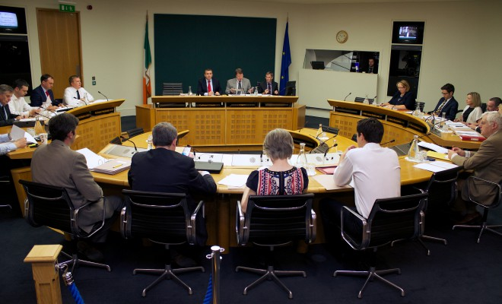
Next steps
Engage with Oireachtas committee examination

Slide 29
Next steps
Extend the campaign coalition

Slide 30
Next steps
Expand social media presence

Slide 31
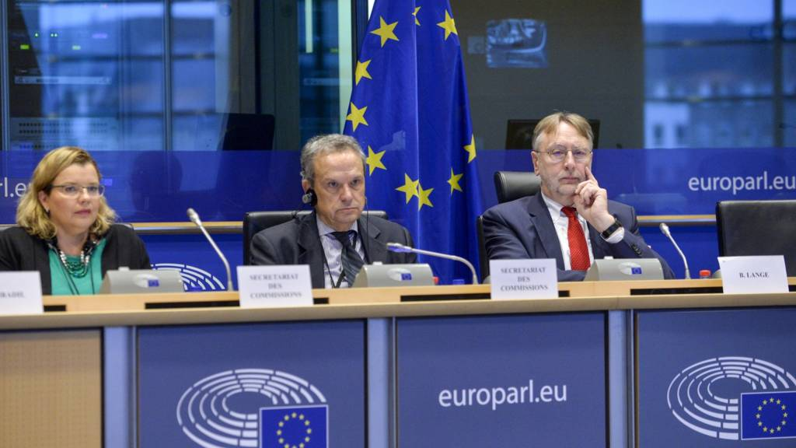
Next steps
Engage with international debate

