Slide 1
Four Day Week Ireland
#4DayWeek #Better4Everyone

Slide 2
2021 Campaign Overview
Public: International petition campaign
Encouraging the public to call on businesses and Government to pilot the Four Day Week
Political: Political engagement strategy
Lobbying the Government to provide a €5m financial aid fund to support businesses to pilot the Four Day Week in Ireland, in line with €50m initiative introduced by Spanish government
Business: Launch of the ‘Four Day Week Institute’
Supporting businesses willing to pilot a four day week with business advice, training, research and monitoring
Unions: IR campaigning and negotiating strategy
Securing the support of public sector bodies (such as local authority departments and sections of government departments) and private companies to participate in the pilot

Slide 3
Campaign Objectives
1. Win the support and buy-in of businesses to participate in the Four Day Week pilot programme.
2. Raise awareness of the Four Day Week campaign, and encourage the general public to engage with the campaign and demonstrate support.
3. Get the Government to pledge financial support [€5m], to support private companies trialling the Four Day Week in Ireland as part of the pilot.
4. Get the Government to commit to trialling the four-day week in sections of both the local authority sector and the civil service, and set up an application process to enable this.

Slide 4
Four Day Week Institute
Coaching and Mentoring.
Access to advice, support and guidance from international business leaders who have successfully implemented the four-day working week.
Training.
Specialised training programme developed covering guidelines on running a successful four-day working week trial, avoiding pitfalls etc., while also integrating best practice around employee engagement and innovation, diversity and sustainability.

Slide 5
Four Day Week Institute
- Accreditation and Promotion.
Company is promoted as a four-day week employer and participant in the pilot programme on campaign website, social media, press releases, promotional materials etc.
*If company commits to the pilot and meets certain conditions (e.g. 32 hour week with no loss of pay, pay their employees a ‘Living Wage’, offer employees option to be represented by a trade union.)
Research and Analysis.
Partnership with academic institution, as part of international research cluster utilising common four-day week methodology (involving Auckland & Oxford), to assess company productivity and employee metrics before and during the trial, and provide
detailed impact analysis report after the trial.

Slide 6
Four Day Week Institute
- Networking and Collaboration.
Access to support structures with other companies participating in the pilot programme, enabling continuous improvement and shared learning throughout the pilot.
- Financial Support.
Contingent on Government backing for pilot proposal.
-

Slide 7
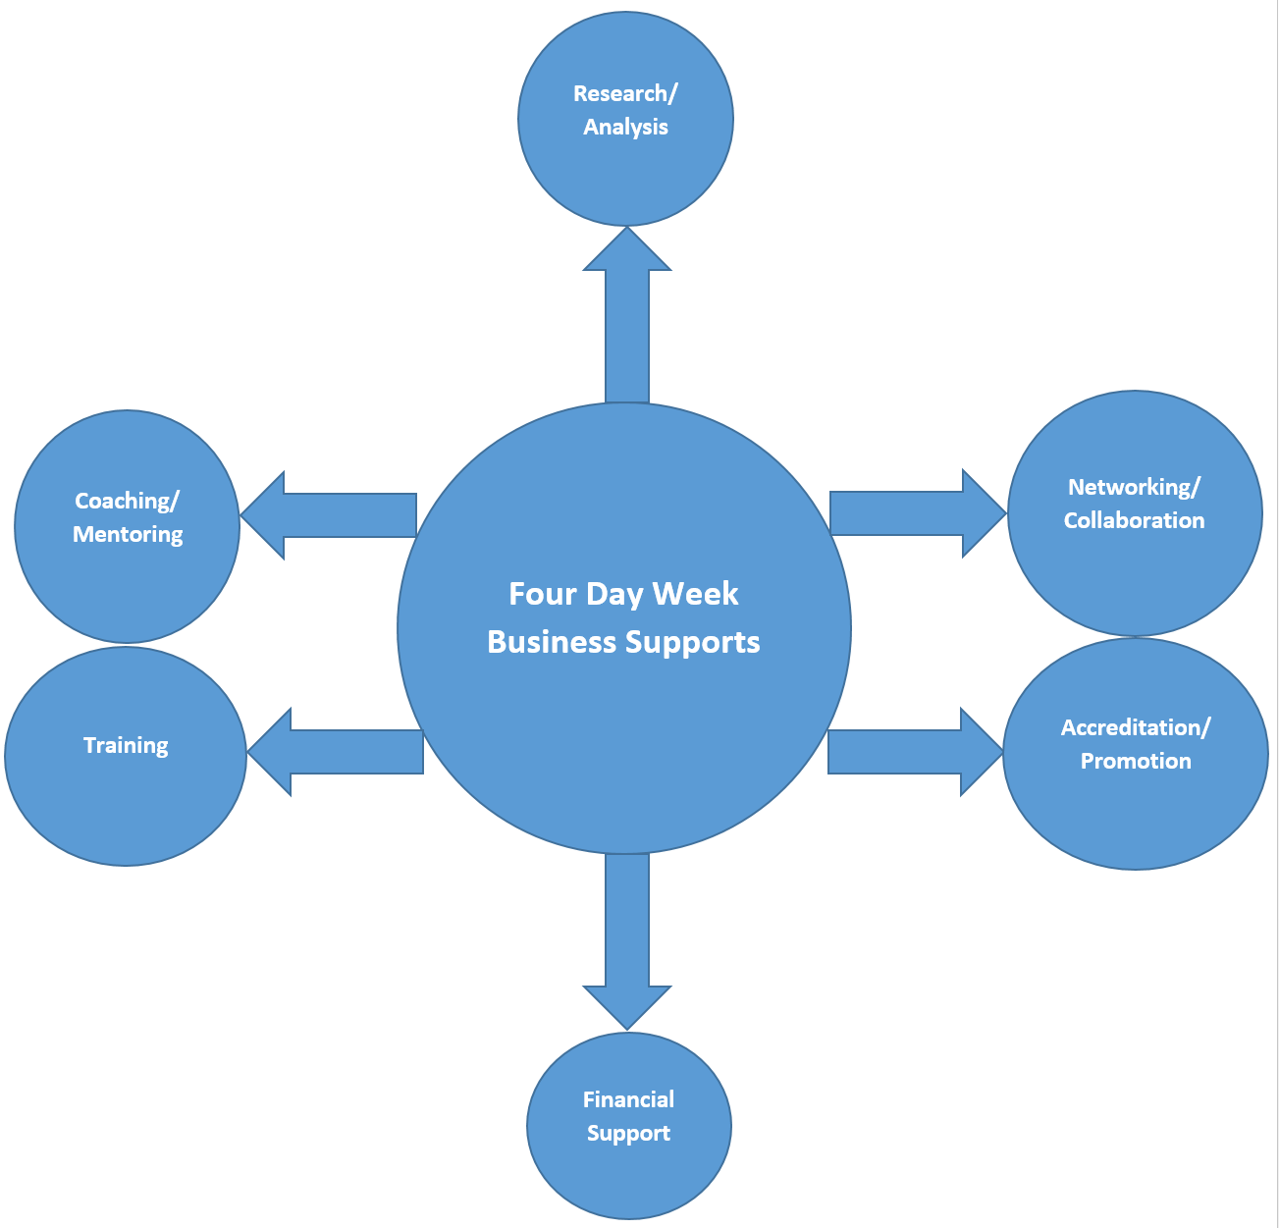

Slide 8
Campaign Timeline
FEBRUARY & MARCH:
- Put 4DW business supports in place – research agreement, training materials, etc.
- Lobby government to support the initiative through commitment to €5m private sector fund and targeted public sector trials.
APRIL:
- Launch Four Day Week ‘Institute’ / announce business supports.
- Announce pilot programme to launch in Sept / Jan 2022 and call for businesses to get in touch for more information if interested in participating.
- Publicly call for government to support the initiative through commitment to €5m private sector fund and targeted public sector trials (if not already agreed and announced
as part of the launch) / Seek support from Opposition.

Slide 9
Campaign Timeline
MAY:
- Launch international petition.
SEPTEMBER:
- Launch coordinated ‘test pilot’.
JANUARY 2022:
- Launch full 6-month pilot programme.

Slide 10
Other relevant items
- Political engagement: Oireachtas committee on ETE
hearing likely to be much later this year.
Coalition building: Need all steering group members to engage with the identification and reachout with potential supporters and allies e.g. other groups from within core campaign pillars, new health pillar, online ‘influencers’.
Website and social media: Have engaged the agency Language on updating website content, and supporting the expansion of our social media presence through the development of a content repository and calendar. Proposal to follow.
-

Slide 11
