Slide 1

Dealing Effectively with the Media
Pat Montague,
Change Advocate, Strategist and Capacity Builder,
Fórsa Trade Union BCO Media Training,
28 March 2019.
Notes:
1

Slide 2

Audience Focus
Start with your audience
Who are you talking to?
Public not your members
What makes them tick – get inside their heads?
Build a bridge from them to you – relate to their experience
What’s the common agenda?

Slide 3

What’s your message?
Needs to be linked with campaign objectives
Getting results not vanity
Not about winners and losers – though media love that
Focus on what do you want public to do
How this will make things better for the public and members?
Make your message stand out
Clarity, simplicity and relevance

Slide 4


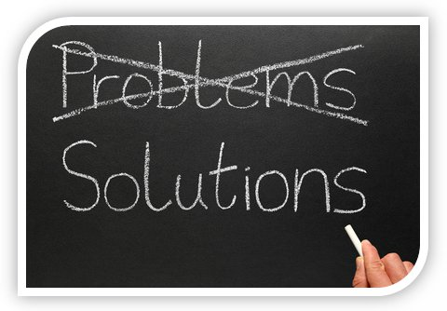
Tone and Tenor
You need to be empathetic – you’re on the public’s side
Focus on solutions – you want to make things better
If you’re criticising, do it with regret not relish
Better to be disappointed not angry
Talk about real people – not statistics
Tell stories!

Slide 5
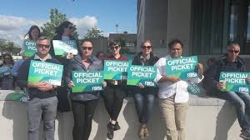
Challenging Context for
Unions
Role of unions being more openly challenged
Blocker/enabler of economic progress
Most journalists have experienced pay cuts –intolerant of ‘pay restoration’
More difficult context to operate within
However, focus on audience – don’t get into disputes with journalists
Relate to ordinary people’s experience – tell stories

Slide 6
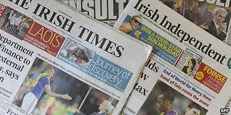
Getting to Know the Media
8 daily papers and 9 Sundays
Almost 60 radio stations
Significant presence of local radio – on average has twice the listenership of RTE Radio One
Lots of local papers and magazines too
Irish TV has 40% of market, British 30% while ‘others’ have 30% and growing
Growing online market too
Fragmentation of media market – collection of audiences rather than one national audience
While consumption of traditional media is declining, Irish still have voracious appetite

Slide 7
Media Context
Drive for cost-cutting affecting journalists
Less staff covering more stories – is affecting standards
Time constraints even greater – increasingly desk-bound and reliant on getting a ‘feed’
Fewer specialists – four Health Corrs
‘Churnalism’ – Nick Davies, Flat Earth News
Still able to pull substantial audience and influence public opinion and policy
Journalists are largely processors of news – can be to our advantage
Provide good ‘ready-to-go’ stories
Understand media’s needs – greater success

Slide 8

What is News?
News is new information which media considers to be of interest to local, national or specialist publics
Colour – pictures, personal insights and human interest stories
Comment, calls or claims on topical issues
Media and trade unions often have differing perspectives on news
Media interest in conflict and aberration – “If it bleeds it leads”
This is why they’re interested in you
Unions interested in delivering change for members – media not that interested
Causes conflict inevitably

Slide 9
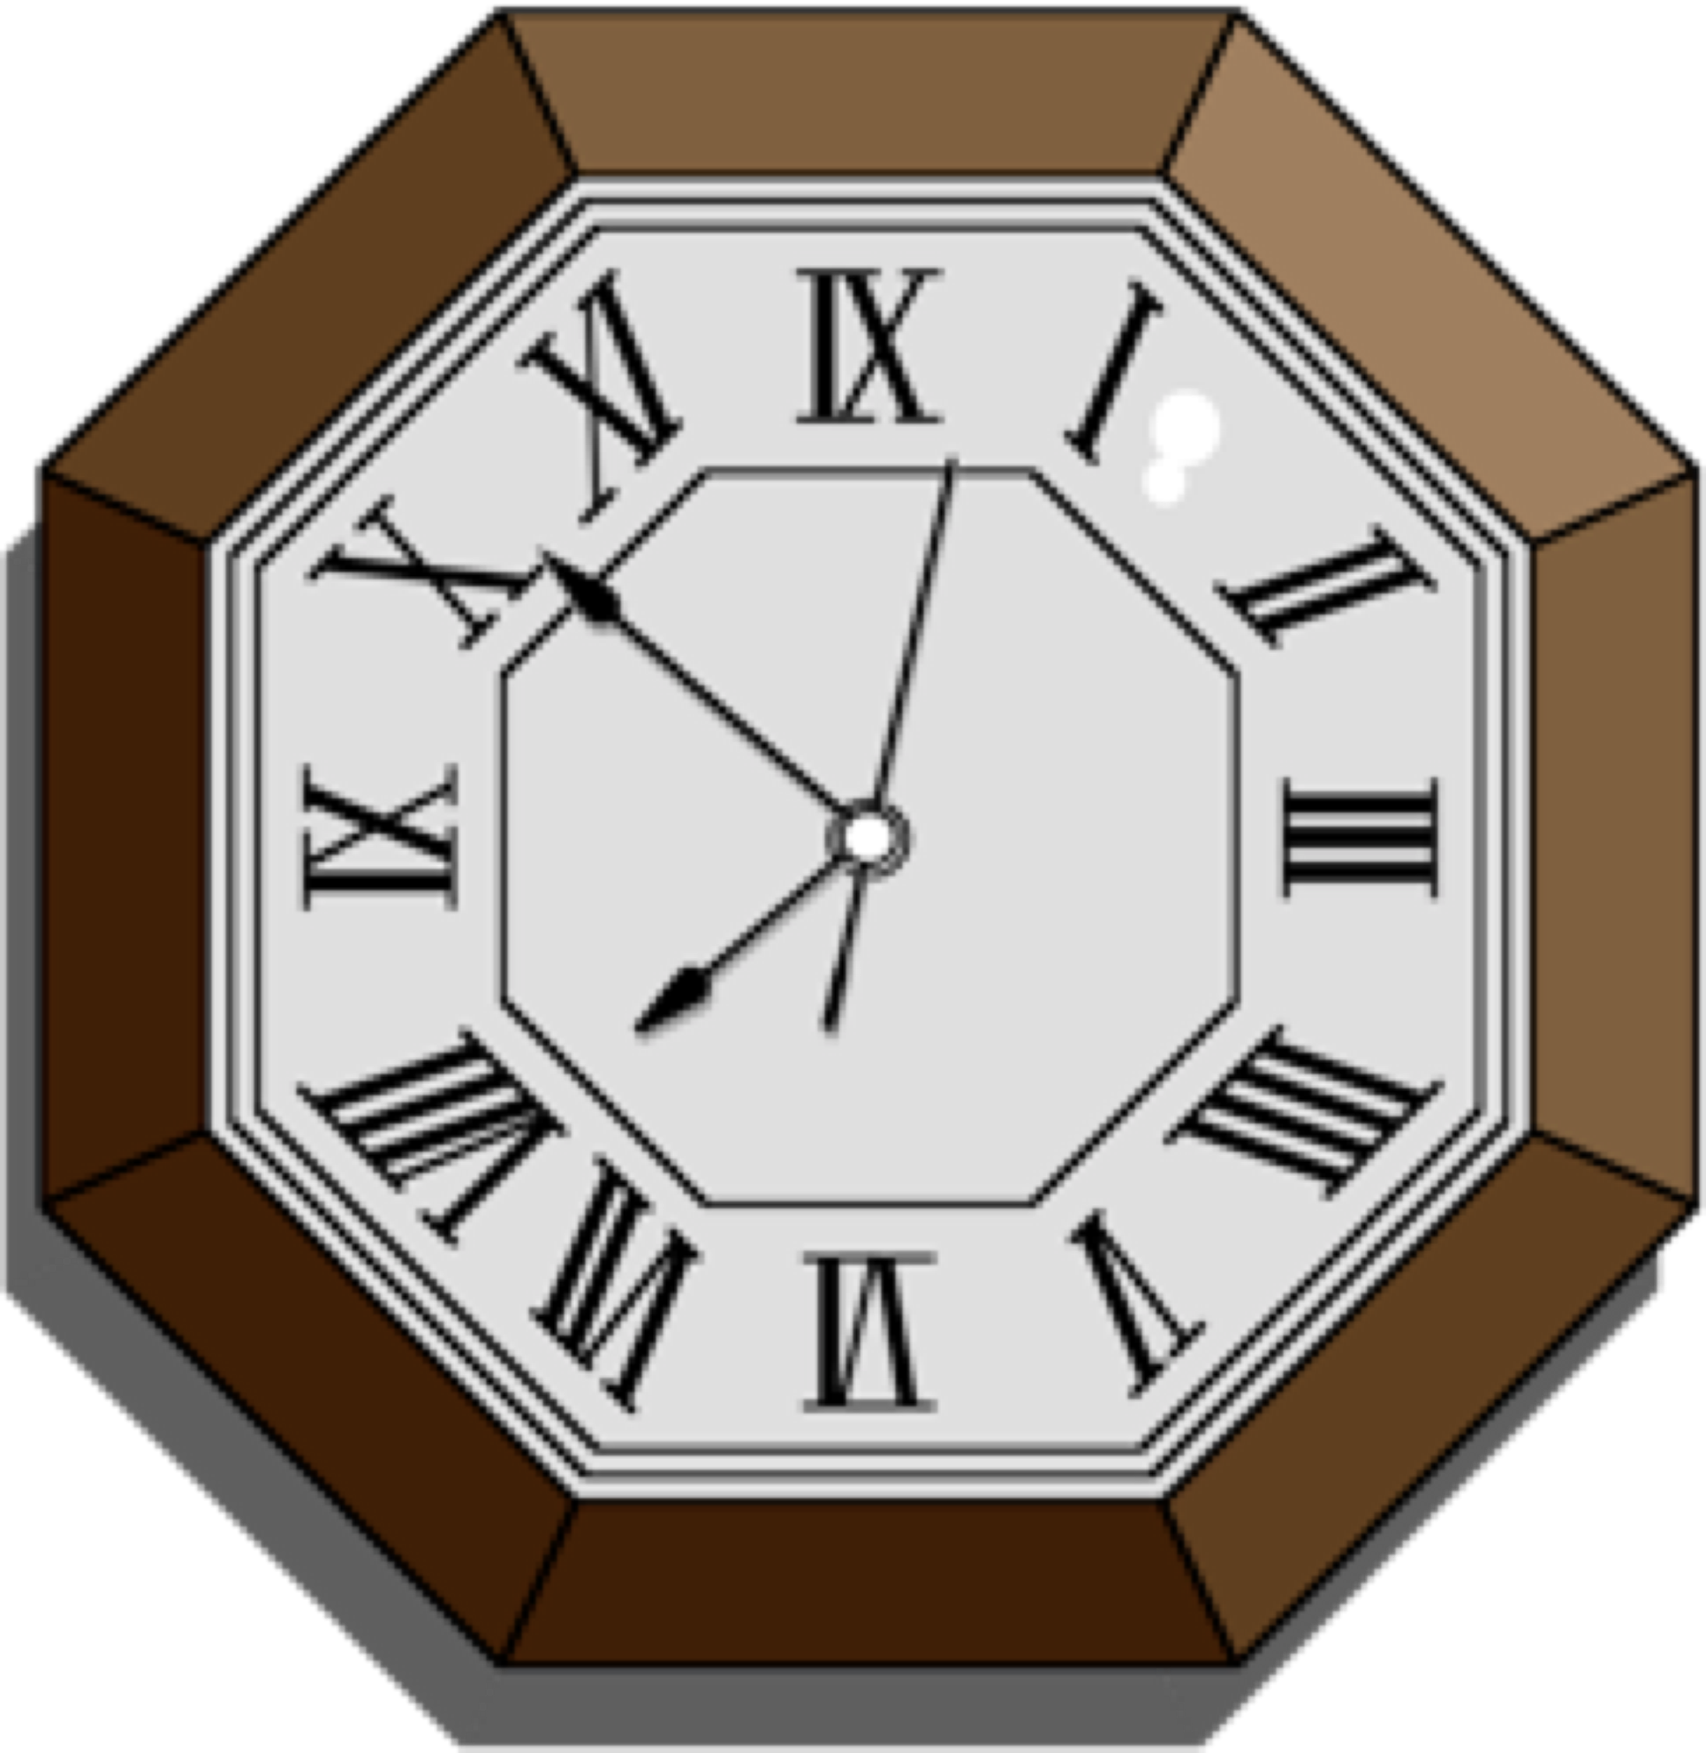
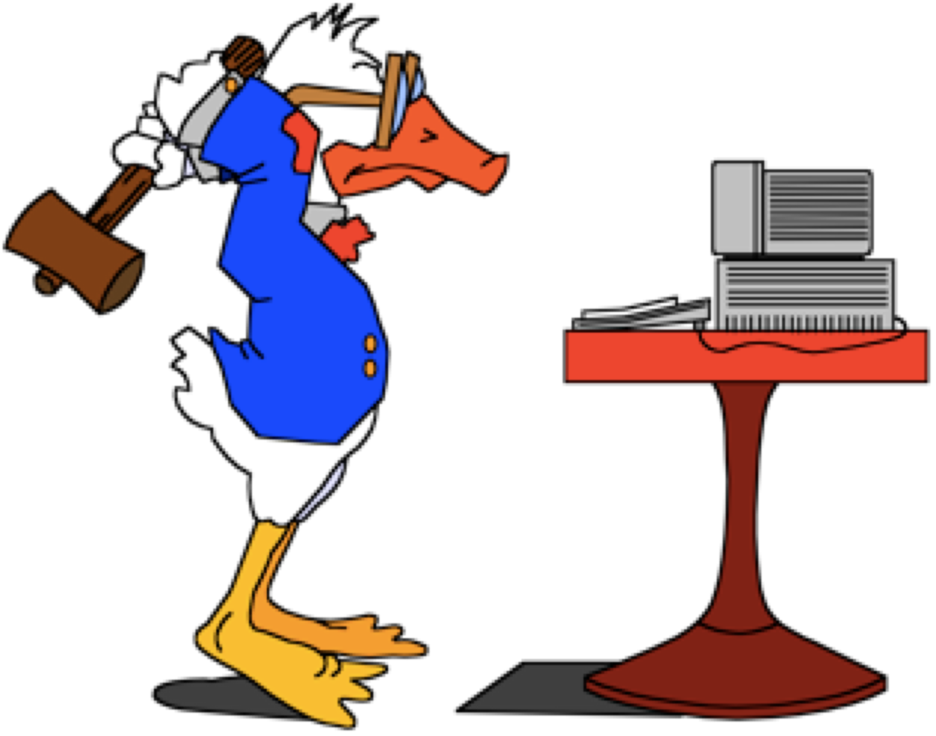
Shaping Influences on Media
constraints of
time
resources
  staff, money, technologies
availability of sources

Slide 10

What Defines Priority News?
Public interest
  Public different in each case
Need to understand the media and tailor message
  Timing
  Other news

Slide 11

It’s all about timing!
Timing is key to driving media coverage
Do weekly press release
Focus on quieter times
Summer, Christmas/New Year
Early in the week – Sundays/Mondays
Early in the day – focus on mornings
Know media deadlines

Slide 12

Also about relationships
Relationships also crucial
You need to know them and they you – meet for coffee
What’s your agenda and how can this translate into stories for them
How can you help them out
Be available and accessible
Keep in touch

Slide 13
Gathering News
Press releases
Supplied scripts
Tip-offs, check calls
Colleagues
Media
Official documentation
Press releases

Slide 14

Don’ts
Be over-awed
Do ‘off the record’ interviews – mug’s game
Say ‘no comment’ – explain why you can’t give an answer
Repeat the negative words of a question
Respond to hypothetical, “what if” questions
Assume too high a knowledge
Waffle, use jargon, initials or acronyms
Be afraid to correct yourself
Argue / lose your temper
Ignore questions
Seek the interviewer's sympathy

Slide 15

Dos
Return phone-calls promptly
Ask them what they’re interested in
Supply information ASAP
Remember interview is live until reporter is gone
Be courteous and patient
Commit yourself

Slide 16
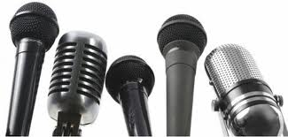
Role of Interviews
Journalists' principal means of gathering information
Journalists looking for:
  new angles on existing stories
  confirmation of own assumptions
  reaction to statements of others
  provocation to others
above all, quotable quotes

Slide 17
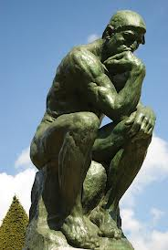
Preparation for Interview
Identify and list all facts
Define three key messages
Anticipate questions
Draw up “danger list”
Practice responses

Slide 18
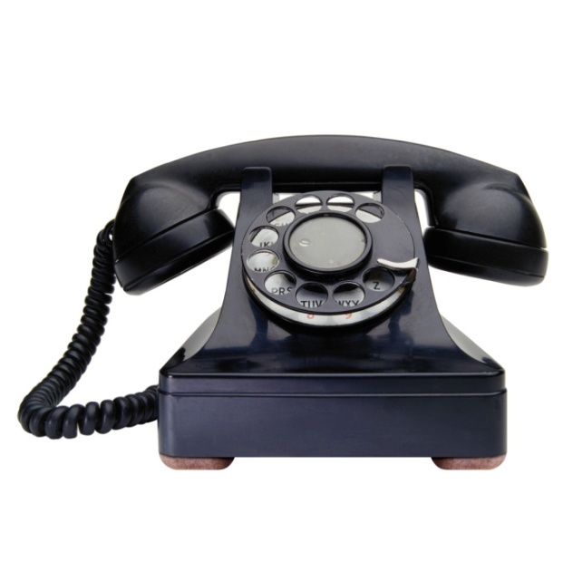
Preparation for Telephone Interview
No need to do interview immediately
Ask what topics are
Write down key points
Choose location – quiet
Avoid speaker phone
Beware of conference calls
No interruptions – turn off mobiles
Listen carefully to questions
Stay simple. Don’t assume journalists and listeners have tables, photos, diagrams
Be sparing on statistics – tell stories

Slide 19
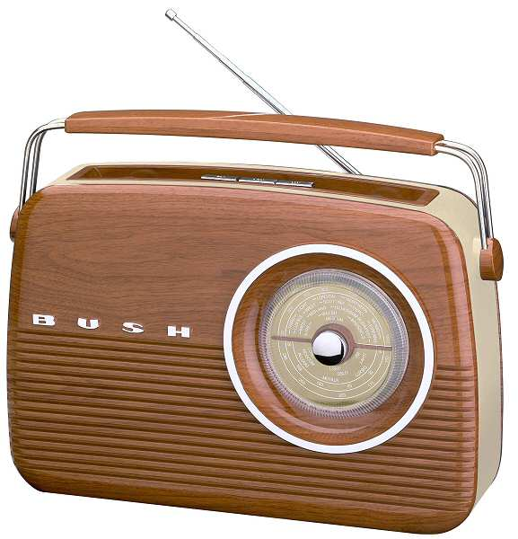
Preparation for Radio Interview
Determine if informal, taped or live-on-air
Make sure name and position understood
Present main points and conclusions first
Ask for direction of questions in advance
Repeat your message
Avoid jargon
Make statements you can support factually

Slide 20

Preparation for TV Interview
Look at interviewer. Don’t worry about camera
Talk with your normal vitality
Remember, smallest gesture is magnified
Be alert to signals to wind-up interview
Be open, friendly and relaxed. Never talk down
Average TV news piece is 40-60 seconds. You may occupy 20 seconds. Make the most of it.

Slide 21
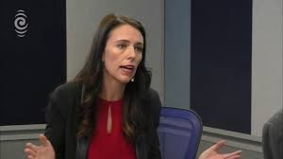
Preparation for TV Interview
When appearing on TV ….
  Be careful about choice of clothes and accessories
  Take a tissue
  Accept studio make-up
  Refuse alcohol
Be yourself!
Remember …
  70% impression comes from how you look
  20% impression comes from how you sound
  10% impression comes from what you say ….
  ….. Unless you say the wrong thing!

