Slide 1
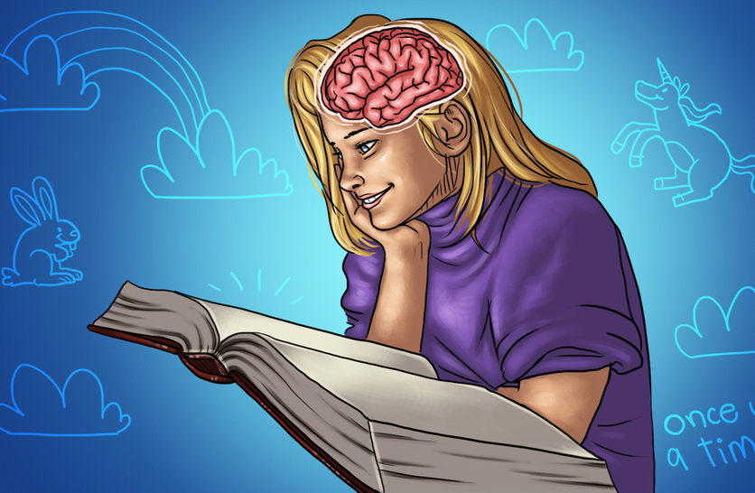

The Science of Storytelling
Today
It’s how we learn and remember
They simplify complexity
They create an emotional connection
They inspire action
People give meaning to data

Slide 2
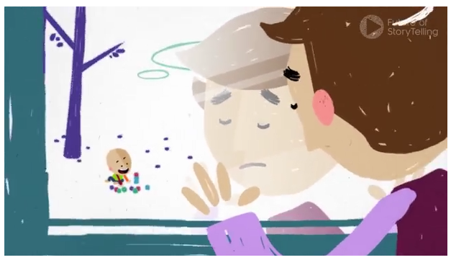
Ben’s story
Today
Dr Paul Zak, Center for Neuroeconomics
Listening to a good story releases
Oxytocin and Cortisol
Transcendent v transactional purpose
A good story promotes trust and recall
Influence

Slide 3
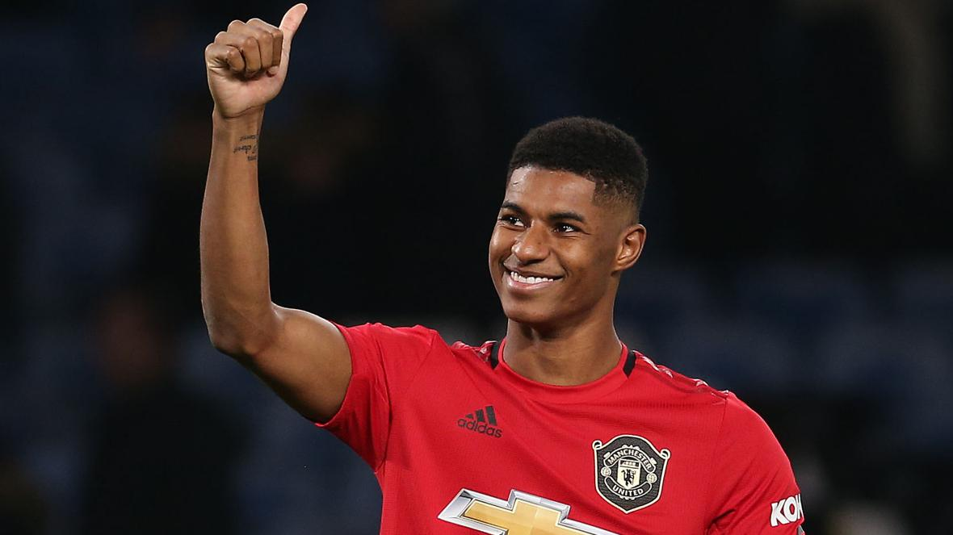

Slide 4
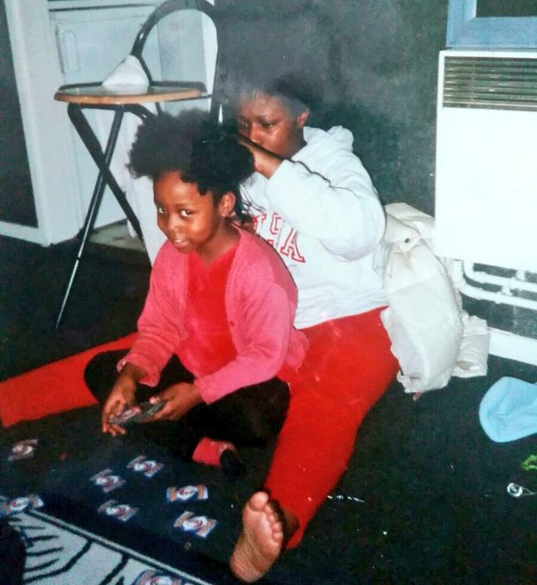
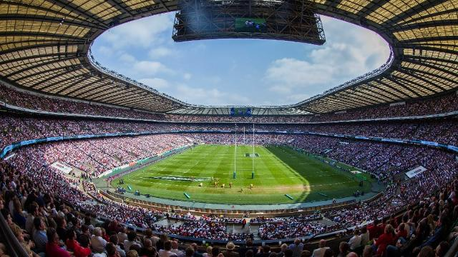
Ditch data
Today

Slide 5
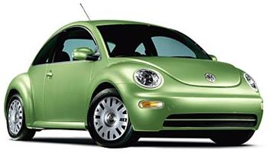
Quick question
Today
Person 1: Where’s John?
Person 2: Well….I didn’t want to say anything. But…I saw a green VW parked outside Carol’s.
What’s happening?

Slide 6
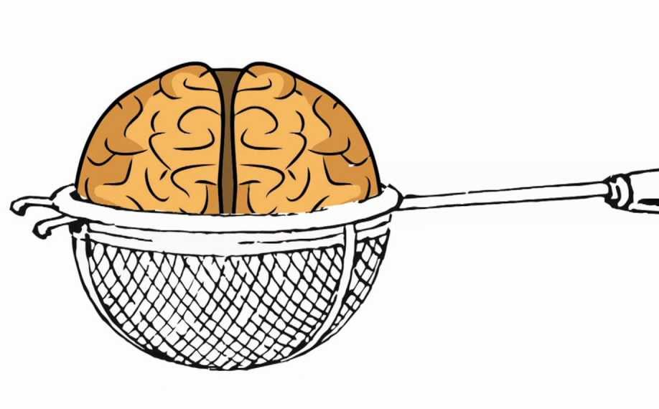
Jettison jargon
Today
Kendall Haven
Neural Story Net
Processes information before it reaches the conscious brain
Filters out jargon and big data
Make Sense Mandate
Gets things wrong or makes them worse!

Slide 7
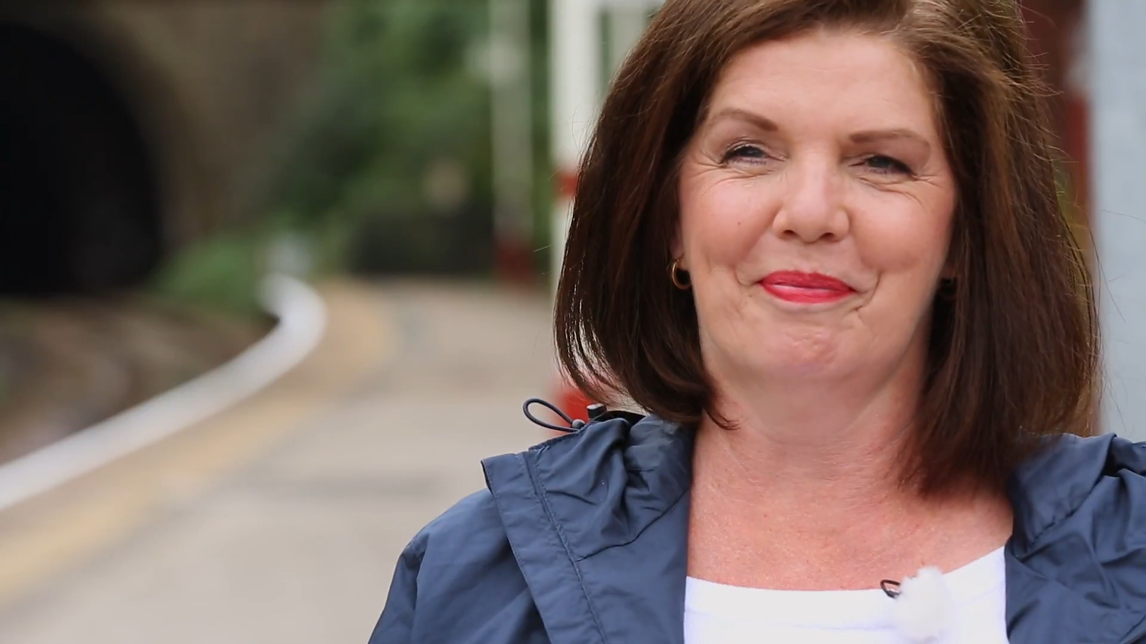
Eight essential ingredients
Character
Traits
Goal
Motives
Conflict and problems
Struggle
Risk and danger
Victory

Slide 8
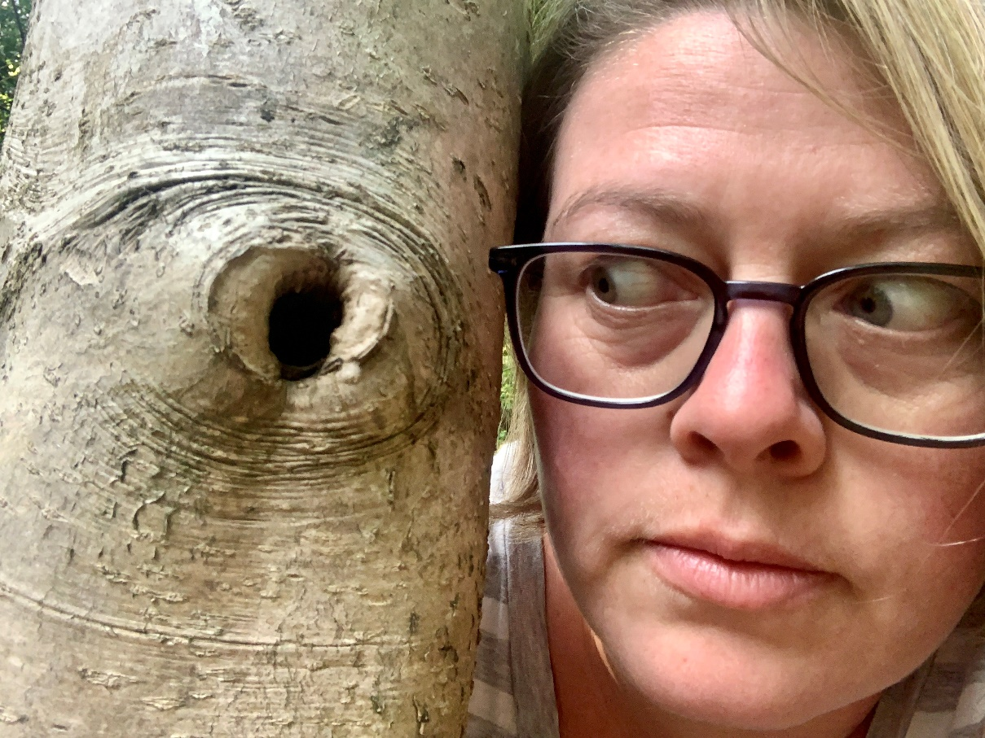
My four day week story
Me, small business owner
Say yes to everything
Work less, earn the same
More time for me and for others
Clients, my own expectations
Lockdown three
Burn out
Survived (probably even thrived)

Slide 9
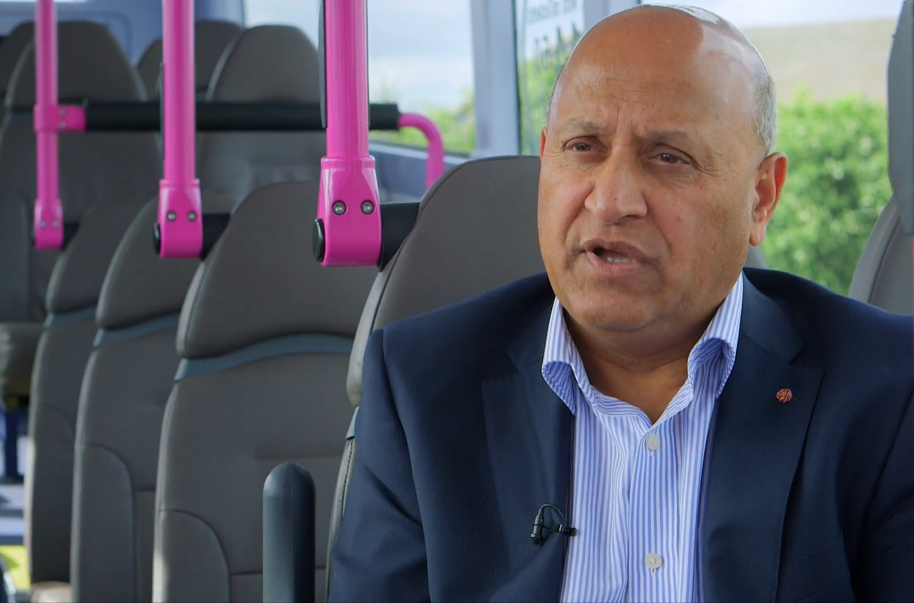
Things to remember
Keep it personal
Let the story do the work – don’t crowbar stats and key messages in
Choose stories that bring your messages to life
It can be you or it can be other people
Consent

