Slide 1
Role of Branch Campaigns Officers Joe O’Connor, Director of Campaigning BCO Meeting – 12 January 2021

Slide 2
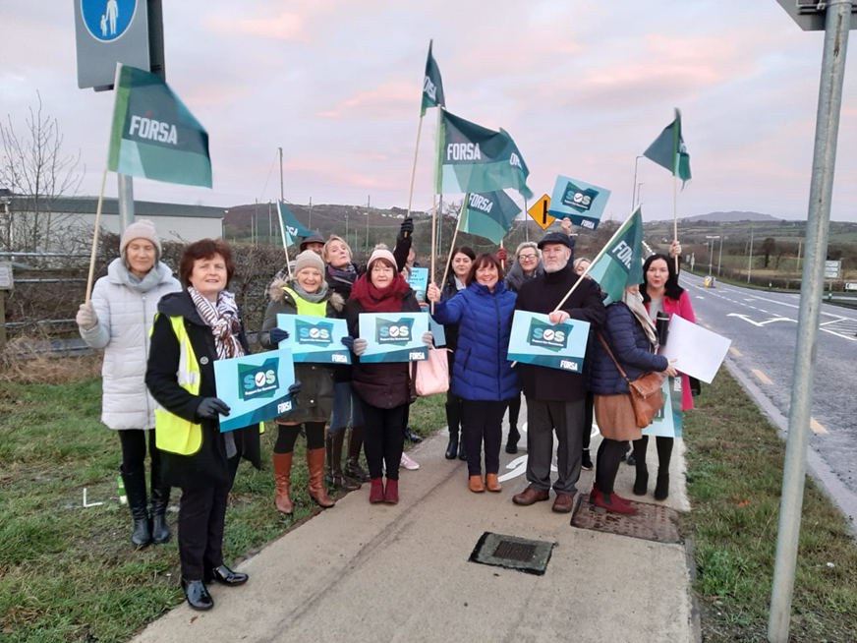
Campaigning in Fórsa
Fórsa – A force for positive change in society
Campaigning in the public and political sphere
Issues that directly affect members in their workplace or daily lives, or wider issues that resonate with our members
Profile building – Internally and externally
Vehicle for change inside and outside the workplace
National, divisional and sectoral – Led by conference and DEC’s
Seeking policy, legislative & funding gains, but also a pre-emptive defensive mechanism

Slide 3
Effective Campaigning – Letting it RIP
Enhancing our Relevance
Growing our Influence
Building our Profile

Slide 4
How BCOs came about
Initially a loose network of some our most committed and engaged activists
Recognised a formal structure needed for further development
Needed to route this through branches – the core unit of democracy in the union
‘A lot of people doing a little bit’
Vision - The engine powering Fórsa’s campaigns

Slide 5
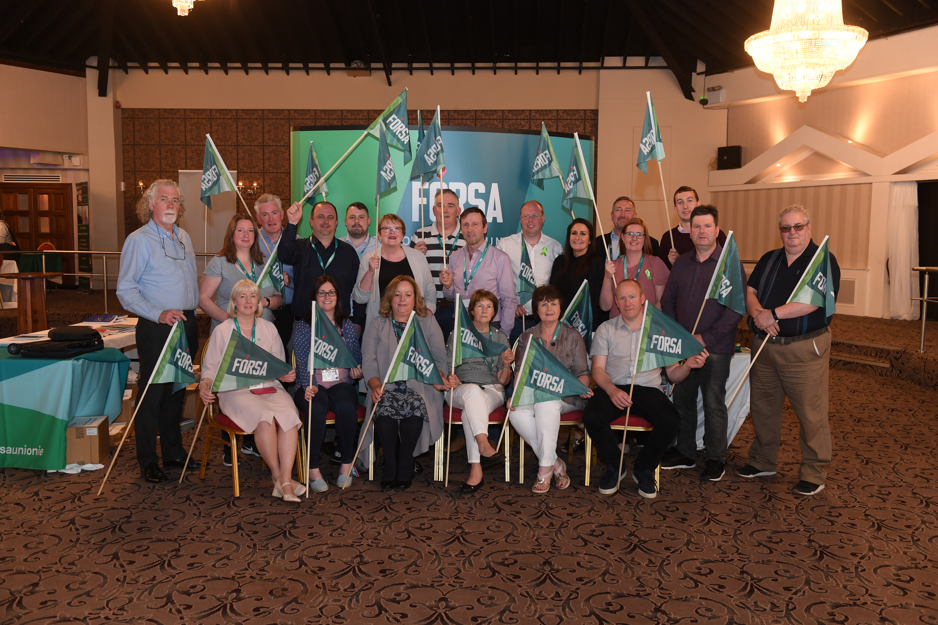
Branch Campaigns Officers
The difference between an advocacy group and a grassroots movement
Grassroots approach - Putting activists at the centre of our campaigns – Harnessing our greatest strength
Enhancing or geographic spread so our campaigns are truly national
Quarterly briefing meetings & training as required – lobbying, local media, etc.
Annual Campaigning Summer School / Summer Series event

Slide 6
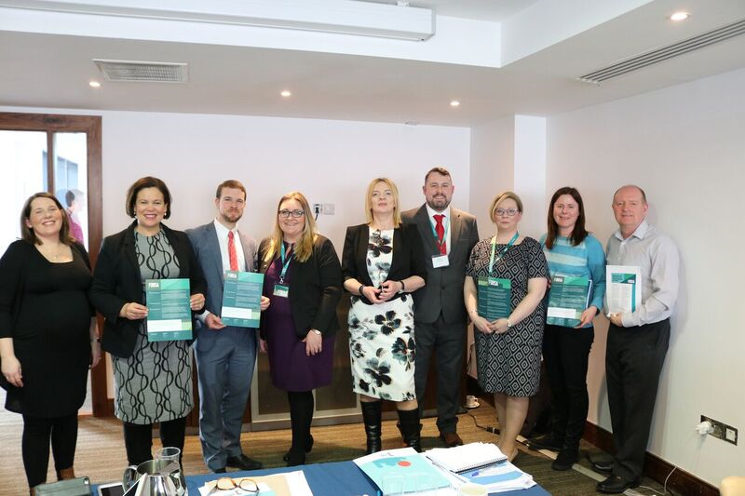
Role of the BCO
Providing local support to amplify our local campaigns
Constituency level lobbying on priority Fórsa issues &
developing strong working relationships with local public representatives (‘All politics local’ in Ireland)
Communicating with the branch on Fórsa’s national campaigning initiatives
Engaging with local media – Leverage their influence outside of Dublin

Slide 7
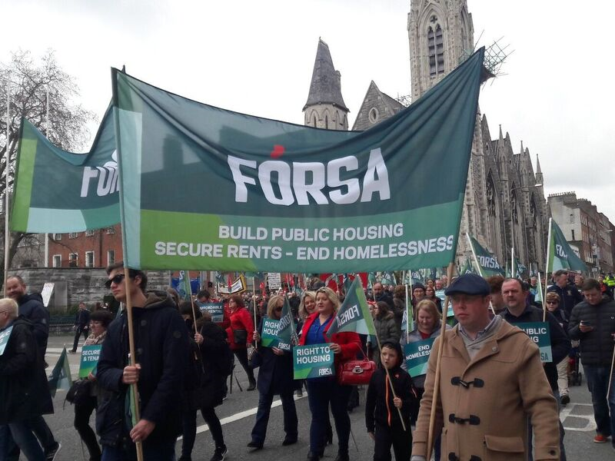
Role of the BCO
Sourcing personal stories and testimonies to boost our campaigns
Assisting with the organisation and promotion of local information events or public meetings
Involving more members in our campaigns at a county or constituency level
Mobilising members for petitions, protests, actions etc.

Slide 8
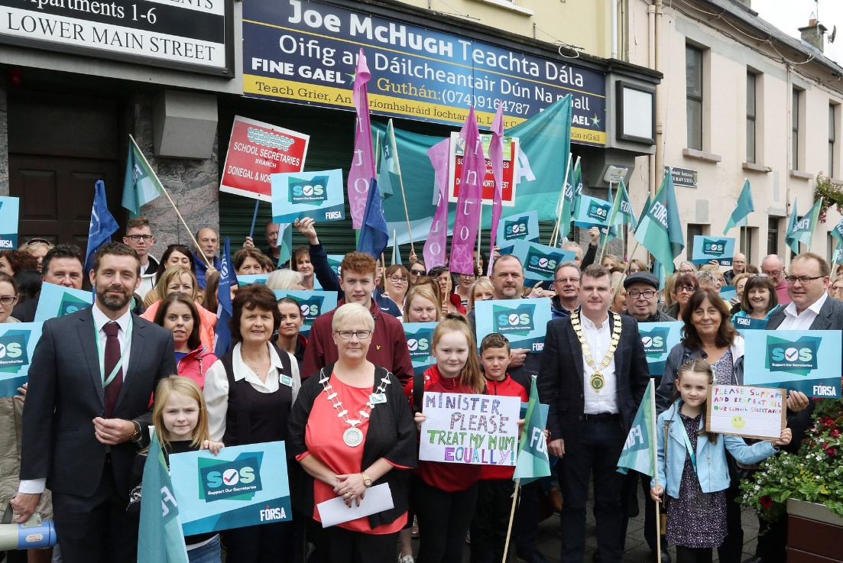
The BCO Network
Breaking down silos
Building community
Enhancing solidarity
Objective: A cross-divisional, multi-branch group of activists in every county and constituency. A campaigning force to be reckoned with right across the country

Slide 9
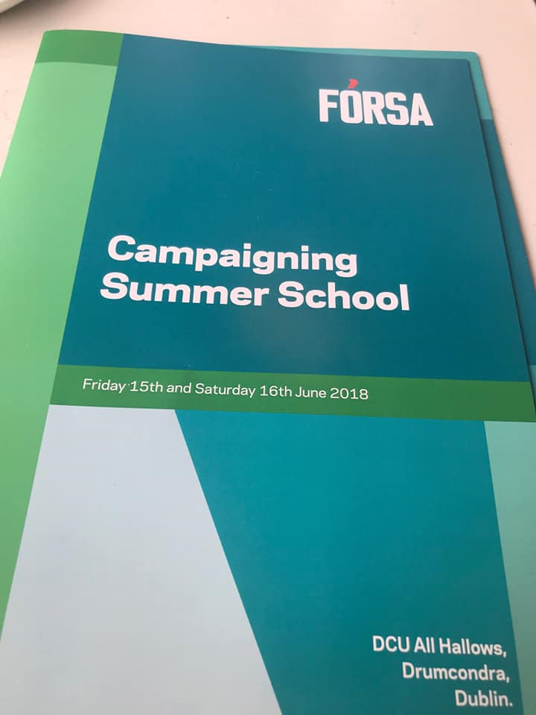
Campaigning Summer School / Series
For BCO’s and senior union activists
Designed to equip key Fórsa activists with the skills and tools to contribute effectively to Fórsa’s campaigns nationally and locally
Training modules and guest speakers
An opportunity to talk about the bigger issues and challenges. To think about new ideas. To learn new tools, skills and approaches. To move outside our comfort zone and have perceptions challenged. To motivate and inspire

Slide 10
Strategic Plan – Campaigning & Influencing
3.1. Developing a systematic approach to political campaigning and lobbying.
Ensure Fórsa’s campaigns are aligned with our overall strategic and organisational objectives.
Develop cross-party, reciprocal relationships across the political spectrum, and ensure consistent and structured outreach and engagement.
Empower members and branches to play a key role in coordinating and driving grassroots political campaigning and local lobbying, to maximise our political power and leverage.

Slide 11
Strategic Plan – Campaigning & Influencing
3.2. Delivering our campaign objectives.
Develop systems and processes to ensure that our campaigning, influencing and lobbying efforts are sustained, consistent and delivered at scale, both nationally and locally.
Review how we support and resource our campaign and policy objectives through policy development and research support.
Provide specialised training and education programmes for staff and activists on campaigning and lobbying.

Slide 12
Campaigning Work Programme 2021 Joe O’Connor, Director of Campaigning BCO Meeting – 12 January 2021

Slide 13
Review of relevant conference motions
NEC national priorities (motions 24, 69, 106)
Housing, Waste, Water (More Power to You)
Sláintecare
Outsourcing in the Civil Service
Childcare
Automation
4-Day Week / Public Holidays / Flexible Working / Working Time

Slide 14
Review of relevant conference motions
Four day week / working time – 106 to 114
Collective bargaining – 64 to 68
Social dialogue – 34, 60, 248
Climate change / green new deal – 55, 59, 62
Housing & homelessness – 37 to 39, 245
Future of work, automation and the gig economy – 69, 100, 247
Remote working – 93, 98, 134

Slide 15
National priority campaigns
Immediate Priority: Working Time / Flexible Working (Four Day Week Ireland / ‘New Ways of Working’)
Ongoing Activity: Housing (Raise the Roof / Home for Good) / Climate Action
In Development: Collective Bargaining (‘Workers Together’)

Slide 16
Divisional engagements
Review of current activity
Assessment of priorities across each division
Discussion on resources required to deliver on our objectives
Discussion on sequencing

Slide 17
Health & Welfare priority campaigns
Immediate Priority: Caring – At What Cost? (Section 39 workers) / Mental health service funding / Profile and political awareness building
Ongoing Activity: Hidden Heroes phase 2 complete
In Development: Universal Healthcare campaign

Slide 18
Education priority campaigns
Immediate Priority: Caretaker Profile Building & Recruitment
Ongoing Activity: Support our Secretaries / Safety for SNAs / Education Futures
In Development: SNA Professionalisation

Slide 19
LGLS / Muno priority campaigns
Immediate Priority: More Power to You Phase 2 – Waste, Water & Energy
Ongoing Activity: Housing (Raise the Roof / Home for Good)
In Development: N/A

Slide 20
Civil Service priority campaigns
Immediate Priority: Access to State IR machinery / Working Time & Flexible Working
Ongoing Activity: N/A
In Development: Outsourcing / Labour Activation campaign (DEASP)

Slide 21
Services & Enterprises priority campaigns
Immediate Priority: Airline Industry (Cabin Crew) / TBD following meeting with new HOD
Ongoing Activity: Pension Justice for CE Supervisors
In Development: Collective bargaining (Workers Together) – to include issues around access, recognition, representation & bogus self-employment

