Slide 1
Public Speaking Training for Fórsa Trade Union
Pat Montague,
Change Advocate, Strategist and Capacity Builder,
March 2021.

Slide 2
Connecting
Twitter Handle
@patmontague
Email Address
pat@montaguecomms.ie
Website
www.montaguecomms.ie

Slide 3
Some Basics

Slide 4
Great Opportunity
Speaking at Fórsa events or to politicians are great opportunities
Influence Government policy and one of largest and most respected unions
Motivate politicians and thousands of members to act
Connect with wider public through local media
Example of DCC activist Mark Wynne on Smoke-Free policies
‘Support Our Secretaries’ campaign

Slide 5
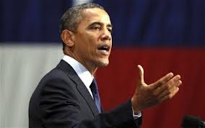
Singular Focus
People don’t remember much of what they hear – so focus & keep it simple
Concentrate on one theme – make it stick in the memory
What do you want them to take away?
Focus on what do you want people to do afterwards
Tell a great story to illustrate the theme
Spare the stats – use one killer statistic
Not for your personal vanity – why are you of interest?
Make your message stand out
Clarity, simplicity and relevance

Slide 6
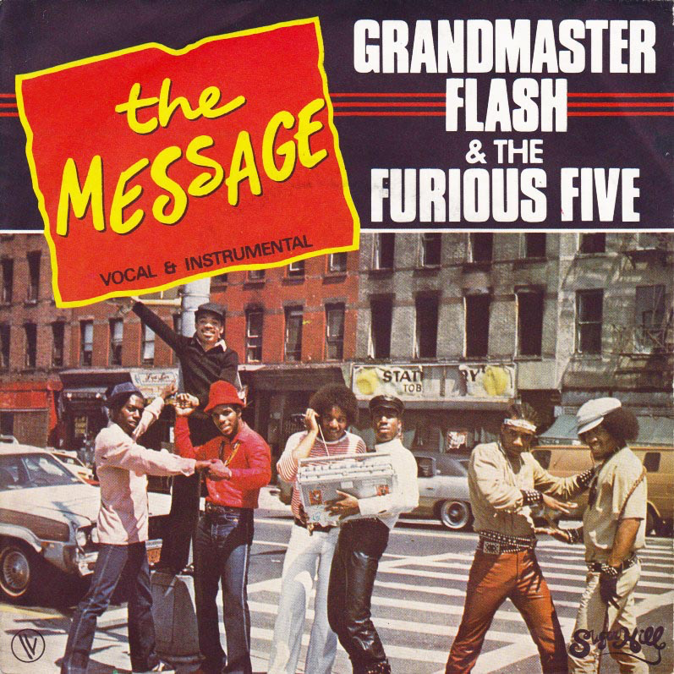
Clear Message
Be clear on core message – about action
Add supplementary information to support it
Be wary of too much detail and loads of figures
What do you want union or Government to do?
What are the benefits to audience and wider community
Build speech around these points
Tell them what you are going to tell them; tell them; tell them again

Slide 7
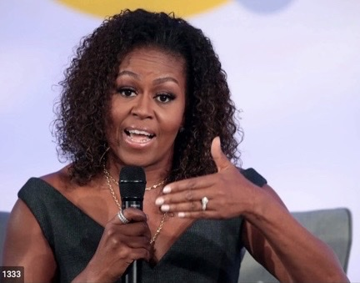
Tell a Great Story
Tell great stories to illustrate your theme
Do some research – talk to colleagues
Spare the stats – use just one killer statistic
Limit acronyms (DEC for example)
This is about you and thousands of people like you
Prepare in advance
Localise and humanise!

Slide 8
Think about your Audience
Start with your audience
Who are you talking to?
Inside and outside the room
Not just your branch colleagues
Why are you talking to them?
What makes them tick? – get inside their heads
What’s the common ground? – build on it
Create a bridge from them to you – relate to their experience
Work the room

Slide 9
Tone and Tenor
You need to be empathetic – you’re on their side
Focus on solutions – you want to make things better
However, sometimes we have to hold the line
If you’re criticising, do it with regret not relish
Better to be disappointed not angry
Talk about real people not ‘members’

Slide 10
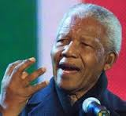
Public Speaking

Slide 11
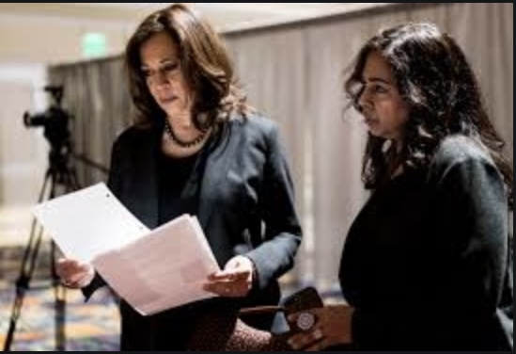
Preparing Your Presentation
Prepare an outline first –skeleton
Write your presentation out fully first – don’t edit/criticise it
Be creative!
Rewrite it to make sure it’s in line with outline
Edit, re-edit and edit again
Use a spell-check
Think about big words – replace with more commonly used

Slide 12
Using Prompts
If you can, try not to use a script – can be boring and monotonous
Too formal and unfriendly
Use notes/cards to remind you of key ideas
Maybe write down introduction and ending – key parts of speech
Eases you in and helps you make a strong finish

Slide 13
Managing Your Nerves
Audience wants you to do well
Allow plenty of time for preparation
Be confident and engage
You don’t look as nervous as you feel
Break the ice with audience at start
If all else fails, don’t panic – breathe deeply
Move and speak slowly, stand or sit straight
Grip the podium, face your audience and look them in the eye
Smile and keep your body open
If there is a problem, ask the audience for help

Slide 14
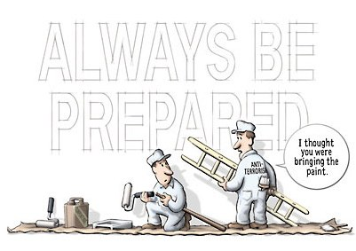
Preparing Yourself
Prepare out loud
Get a friend or colleague (Niall or Bernard) to critique – amend and improve
Time yourself – delete material if required
Turn up early and suss out the venue
Have equipment set up and work out room layout
Do dry-run
You’re ready to perform!

Slide 15
Thinking About Your Content
Be clear on your key message – two/three stories to illustrate it
Keep ‘thank yous’ to a minimum
You need to grab audience’s attention from the start
Begin with a framing story that suggests what the topic is all about
Think about examples to illustrate difficult to understand points
Tell anecdotes or find some good quotes online

Slide 16
Timing is Vital
Keep your speech short – no more than three or four minutes
Make your speech shorter than the allocated time – it will take longer to deliver in reality
Take your time at the beginning and end of your speech – slow down
Time it when you practice
Will help you prevent overruns
Need to edit, edit and edit again

Slide 17
Practice, Practice…
You need to practice your speech out loud
How does it sound?
Is there anything missing?
What needs to be changed?
Record it on your computer or phone and listen back
Rehearse it in front of an audience
Get their feedback
Amend or not

Slide 18
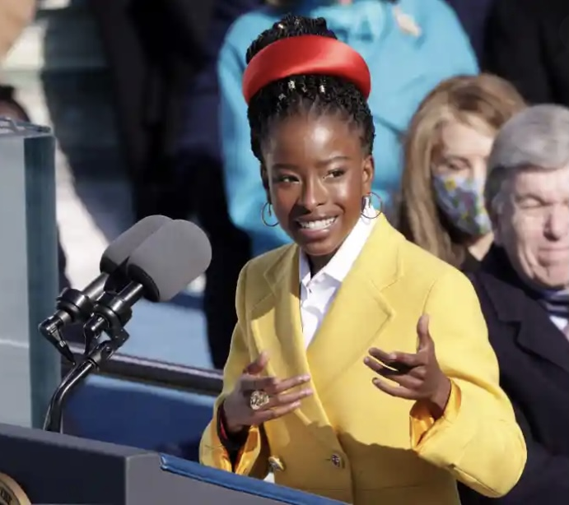
Delivering Your Presentation
Don’t read your presentation – use cards with key points
Place your cards on the lectern or table in front of you
If you forget something, take a breath and look at your cards
Stand/sit up straight and look at your audience
Hold on to the lectern/table/chair to keep you straight
Project your voice so that you can be heard clearly – head up and looking forward

Slide 19
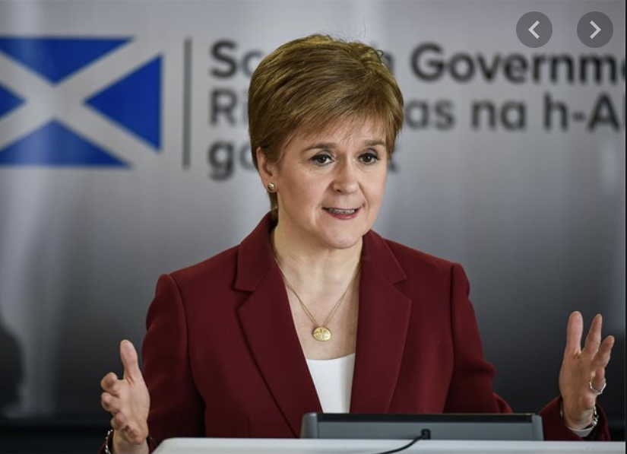
Appearance and Body Language
How you look is important – do you want them talking about clothes or presentation
Smart casual – what would impress you?
Your body language is critical for connecting with your audience
Convey enthusiasm for your topic and openness to audience
No folded arms or hands in pocket
Talk with your hands like an Italian
Don’t use aggressive gestures – only connect with already converted and alienate rest

